Slide 1
KS1 Math’s Workshop
“Pure Mathematics is, in its way, the poetry of logical ideas.”
Albert Einstein

Slide 2
What are we going to cover?
Maths at St Peter’s
Daily Fluency Sessions
Independent Learning Tasks
Tools to support learning
Methods and strategies taught
How can you help at home?
Notes:
LP

Slide 3
Maths at St Peter’s
At St. Peter’s we want children to develop deep and sustainable subject knowledge. We achieve this by focusing teaching and learning on:
Fluency – mental agility, slick written methods and clarity of language.
Problem solving and reasoning – pupils develop a range of skills that allow them to ‘crack’ into and solve a range of problem
Teaching for mastery. All lessons are planned and delivered with the 5 principles of mastery in mind: Cohesion, representation and structure, fluency, variation and deep mathematical thinking.

Slide 4
Number Sense Daily Sessions
Rather than children learning number facts in isolation and by simply memorising them, this systematic and structured programme helps children visualise the maths and gives them a deep understanding of number and how they relate to each other. They become fluent in addition and subtraction facts.
Number Sense teaches a core set of number facts and the calculation strategies you can use to solve them.
Modelled on the phonics programmes used in early reading, the programme groups facts and teaches them systematically alongside the calculation strategies that can be used to solve them.

Slide 5
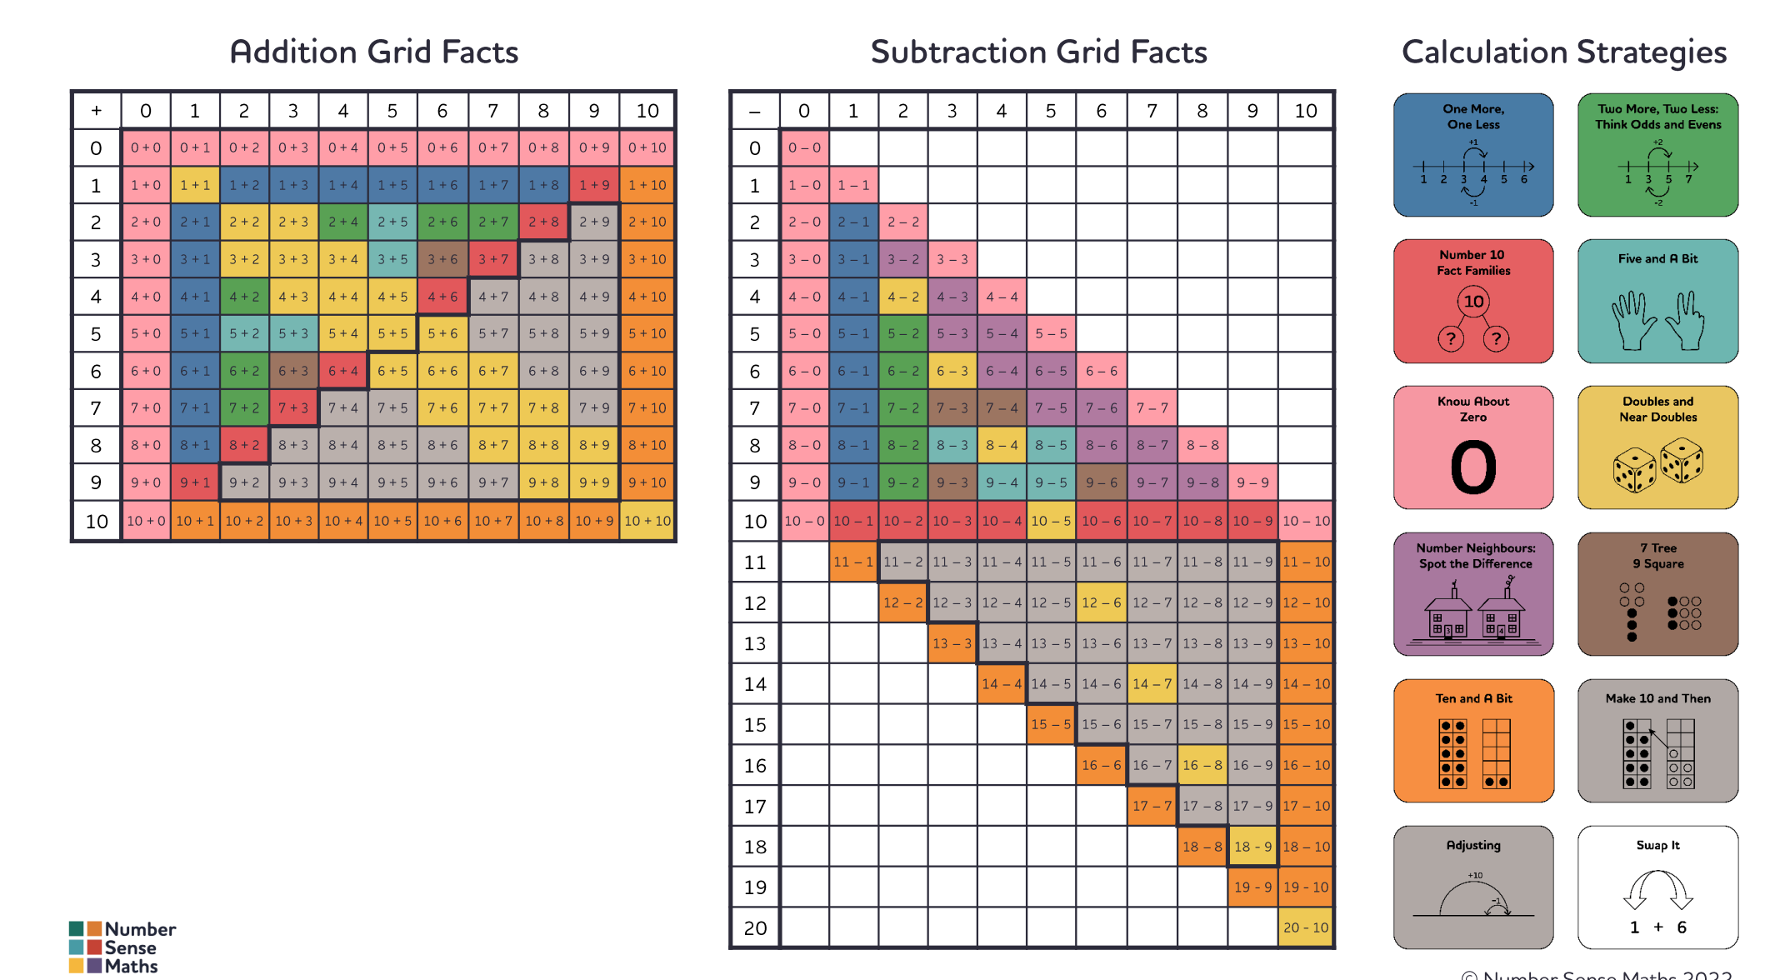
At the core of the programme are the Addition and Subtraction Fact Grids.

Slide 6
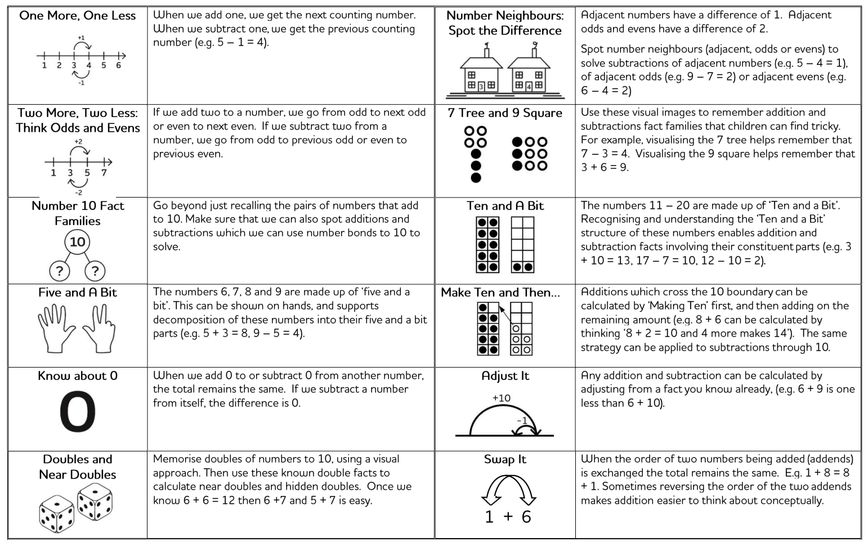
Strategies Taught

Slide 7
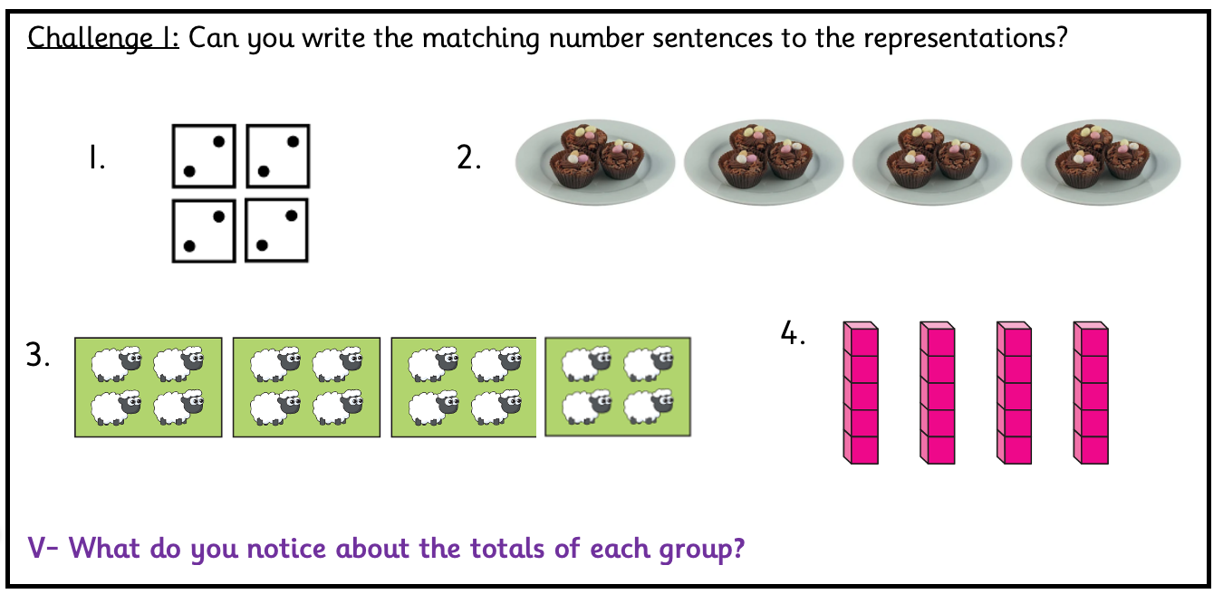
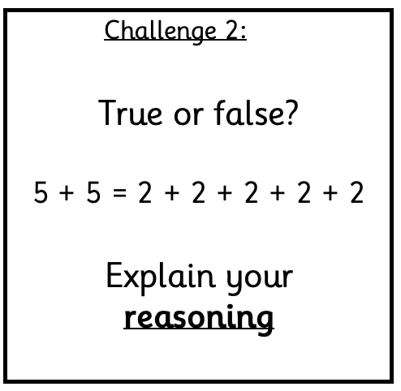
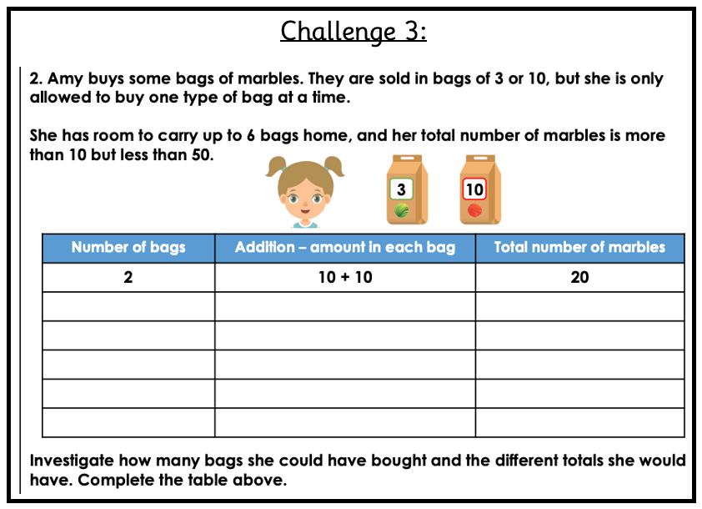
Independent Learning Tasks
Children complete a range of challenges after learning about a new concept. All children will start with challenge 1 and work through to challenge 3.
Challenge 1:
Challenge 2:
Challenge 3
`This challenge is designed to practice the core skills learnt in the lesson.
`This challenge is designed so the children can apply their new learning.
`This challenge is designed to really stretch their thinking., encourage reasoning and problem solve in unfamiliar contexts.

Slide 8
Representation and Structure
Representation and structure refers to how different pictures and models can be used to show a particular number or to explain a concept.
In KS1, we use a wide range of different representations and structures within both the lesson sequence and the independent learning tasks the children complete.

Slide 9

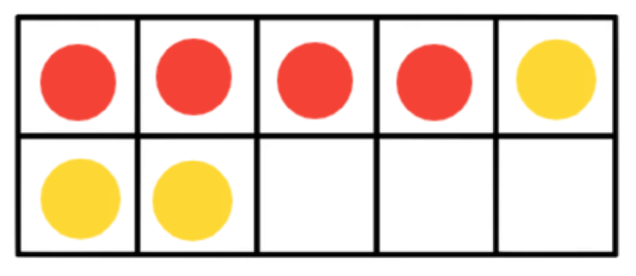
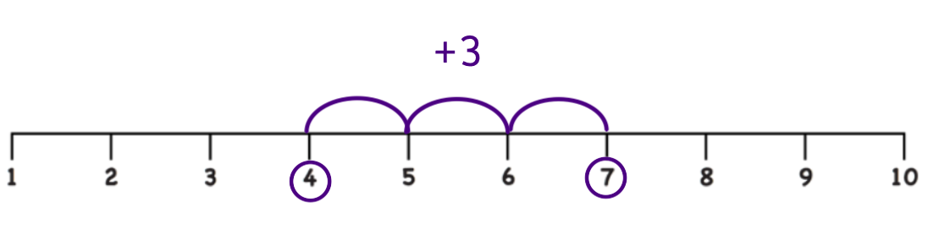
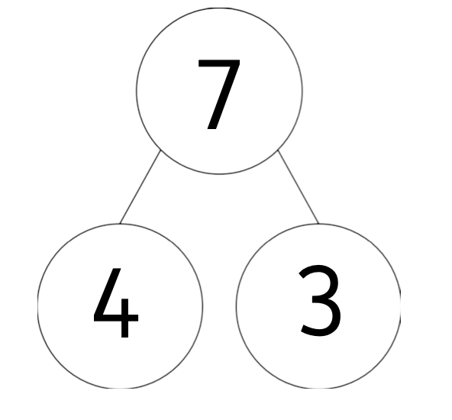
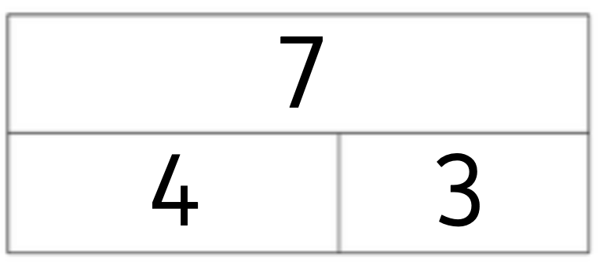
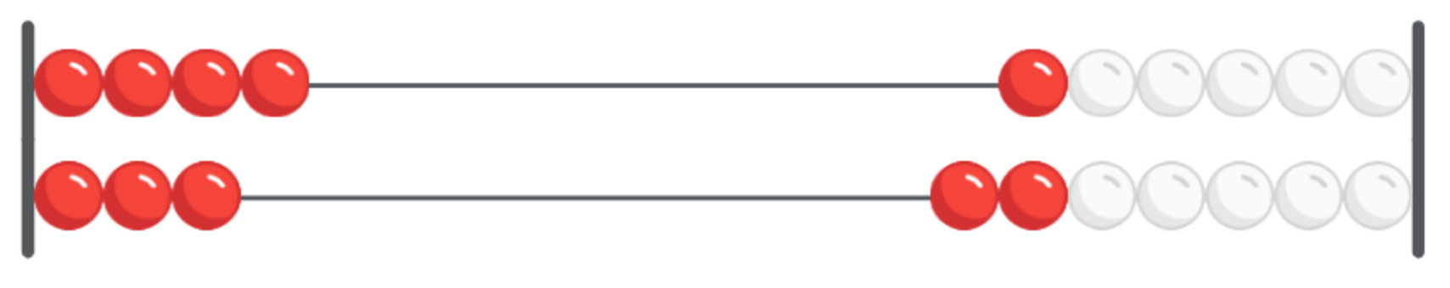
Representation and Structure
Multilink
Number Sentence
Tens Frame
4 + 3 = 7
Number Line
Bar Model
Rekenrek
Part Whole Model

Slide 10
Representation and Structure
Part-whole models and bar models are pictorial representations that show the relationship between a whole and it’s parts. This helps to expose the links between different areas in maths. e.g. The links between addition and subtraction.
4 + 3 = 7
3 + 4 = 7
7 – 4 = 3
7 – 3 = 4
Part Whole Model
Bar Model
whole
whole
part
part
part
part

Slide 11
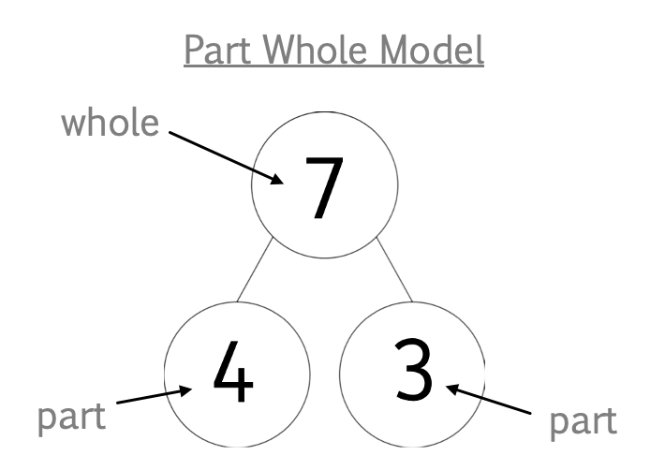
Using Known Facts
If I know… then I know…
If I know 4 + 3 = 7
Then I know 40 + 30 = 70
If I know 7 - 3 = 4
Then I know 70 - 30 = 40

Slide 12
Key Vocabulary
Addition:
Multiplication:
4 + 3 = 7
2 x 3 = 6
addend + addend = sum
factor x factor = product
Subtraction:
Division:
7 - 3 = 4
6 ÷ 2 = 3
minuend - subtrahend = difference
dividend ÷ divisor = quotient
The language of the addition and multiplication can highlight that they are commutative.

Slide 13
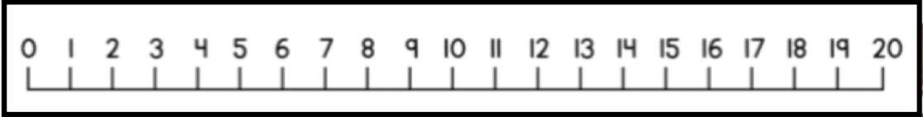
Written Methods
Partitioning: Adding two 2-digit numbers.
Not bridging through 10
Bridging through 10
Method Steps:
Partition into tens and ones.
Add the tens.
3. Add the ones.
4. Recombine the tens and ones
42 + 23 = 65
46 + 27 = 73
40 + 20 = 60
40 + 20 = 60
2 + 3 = 5
6 + 7 = 13
60 + 5 = 65
60 + 13 = 73

Slide 14
Written Methods
Partitioning: Subtracting a 2-digit number from a 2-digit number.
Not bridging through 10
Method Steps:
Partition into tens and ones.
Subtract the tens.
3. Subtract the ones.
4. Recombine the tens and ones
Not bridging through 10
64 - 21 = 43
64 - 21 = 43
60 - 20 = 40
64 - 20 = 44
4 - 1 = 3
44 - 1 = 43
40 + 3 = 43

Slide 15
Written Methods
Partitioning: Subtracting a 2-digit number from a 2-digit number.
Bridging through 10
Bridging through 10
81 - 26 = 55
81 - 26 = 55
70
11
81 - 20 = 61
70 - 20 = 50
61 - 6 =55
11 - 6 = 5
50 + 5 = 55

Slide 16

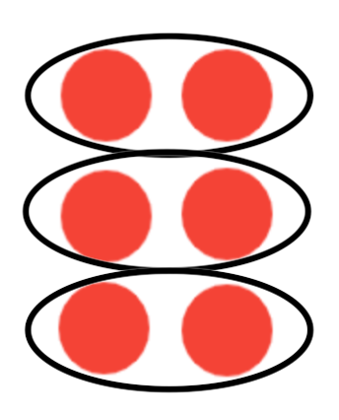

Written Methods
Equal Groups
Multiplication
Array
2 + 2 + 2 = 6
3 groups of 2 equals 6
3 x 2 = 6
Unitising
(seeing the numbers as a group)

Slide 17

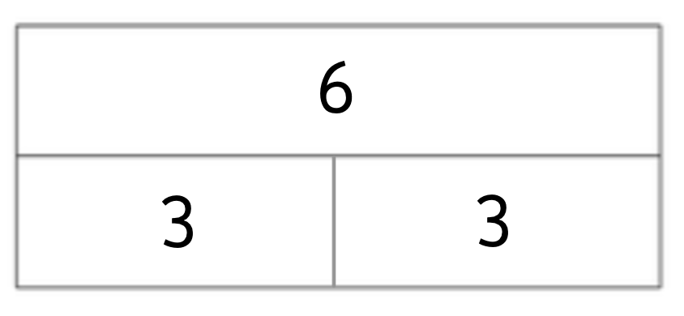
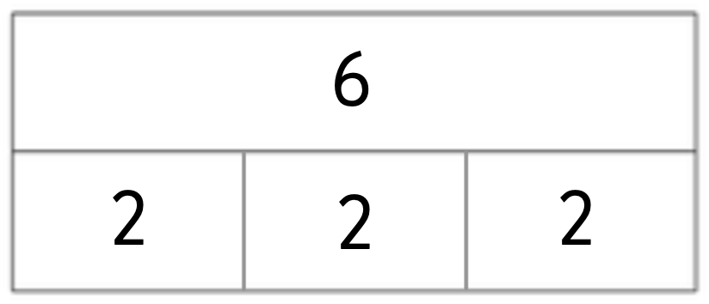
Written Methods
Division
Grouping
6 ÷ 3 = 2
6 divided into groups of 3. There are 2 equal groups.
6 shared equally between 3 groups. There are 2 in each group.
Sharing

Slide 18
What can you do to help at home?
Counting backwards and forwards up to 100 (Year 1).
Counting in 2s, 3s, 5s and 10s.
Practising adding and subtracting within 20 (e.g. 9 + 7 = 16)
Practising rapid recall of number bonds to 10 (e.g. 1 + 9 = 10) and number bonds to 20 (e.g. 11 + 9 = 20).
Rapid recall of 2, 5 and 10 times tables (Year 2 - Times Table Rock Stars – Spring Term
Dojo Home Learning – this will consolidate their basic understanding of number.

