Slide 1


Slide 2

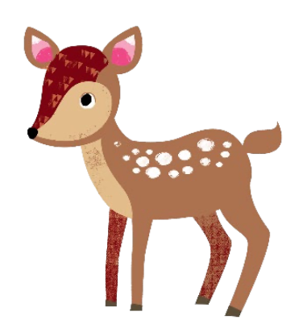
What are we going to cover?
What is phonics?
What is Essential Letters and Sounds?
How we teach phonics
Getting children ready to read
Supporting your child with reading at home
Pronouncing pure sounds
Using the letter formation and spelling sequence to support at home
Year 1 Phonics Screening
Reading at home
Notes:
LP

Slide 3
What is phonics?
A method of teaching beginners to read and pronounce words by learning to associate letters or letter groups with the sounds they represent.
There are 44 main sounds in the English Language. Each sound is represented by a grapheme (the written representation of a sound).
Notes:
SP

Slide 4
What is phonics?
Phoneme: The smallest single identifiable sound in a word. E.g. In the word ‘cat’ there are three phonemes c/a/t.
Grapheme: The written representation of a sound.
Digraph: Two letters making one sound. E.g. /sh/ in the word ‘shop’.
Trigraph: Three ketters making one sound. E.g. /igh/ in the word ‘night’.
Split Digraph: Two vowel letters split but are split by one or more consonants. E.g. /a-e/ in the word ‘cake’.
Notes:
SP

Slide 5
What is ELS?
Essential Letters and Sounds (ELS) is our chosen phonics programme. It teaches children to read by identifying the phonemes (smallest unit of sound) and graphemes (written version of the sound)within words and using these to read words.
Children experience the joy of books and language whilst rapidly acquiring the skills they need to become fluent independent readers and writers.
Notes:
LP

Slide 6
How do we teach phonics?
We use a simple, consistent approach to teaching phonics.
Your child will experience the same classroom routines within each lesson which reduces cognitive load and maximises the chances of success.
All children are supported within the lesson to use their new phonics knowledge independently.
In every single ELS lesson, your child will make the direct application to reading.
Notes:
LP

Slide 7
How do we teach phonics?
Daily Phonics sessions- these start from the beginning of Reception.
Phonics throughout the day to review new sounds & graphemes taught.
Lots of opportunities for oral blending – c/oa/t
Main focus is on word recognition. However, new vocabulary is also given and explained in every lessons. Opportunities for writing – new grapheme, words and sentences.
Notes:
LP

Slide 8
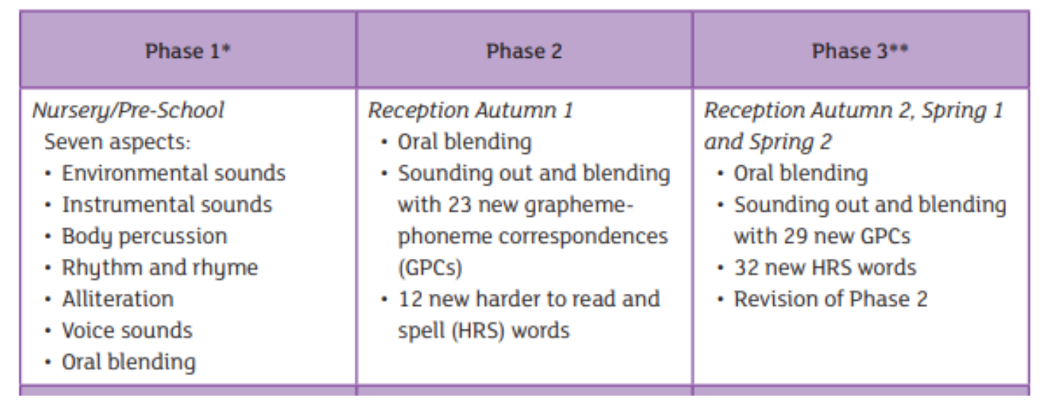
ELS Progression
Notes:
SP

Slide 9
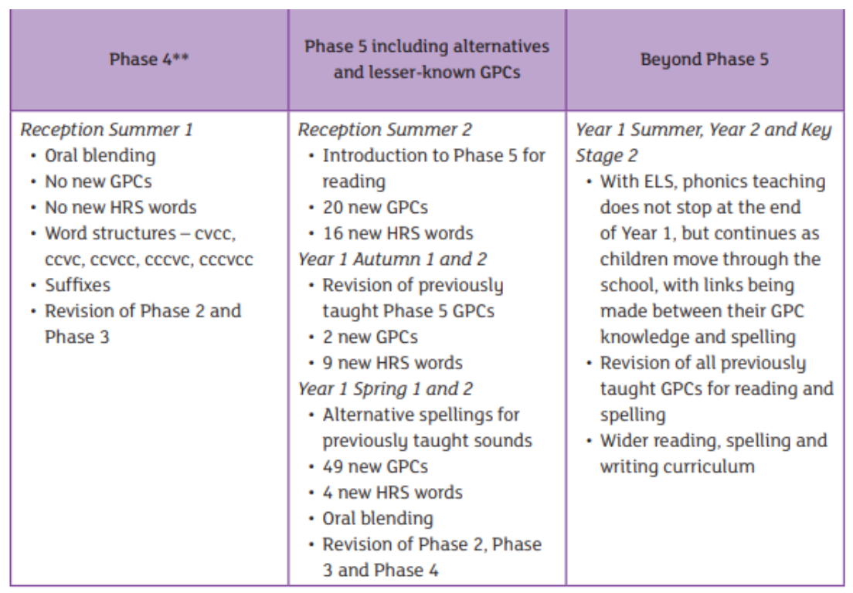
ELS Progression
Notes:
SP

Slide 10
Supporting your child with reading at home
Only 1 in 3 children are read a bedtime story at night.
Reading a bedtime story every night to your child improves their outcomes.
If your child views themselves as a ‘good reader’ when they leave Primary school, they are more likely to earn a higher salary in their 40s.
Notes:
LP

Slide 11
Supporting your child with reading at home
Children are only reading from books that are entirely decodable.
We only use pure sounds when decoding words (no ‘uh’ after the sound’
We want them to practise there reading their book 4 times across the week working on these skills:
Decode
Fluency
Expression
Notes:
LP

Slide 12
Supporting your child with reading at home
We want children to create a strong orthographic map. This means that they learn sounds spelt by the letters or groups of letters in each word.
To read fluently, or well, we need a strong orthographic map.
To consistently recognise that the <ea> in bread spells /e/ we need to read it at least 4 times. This means we need to read the word many times to build fluency for reading.
Notes:
SP

Slide 13
Pronouncing Pure Sounds
We must use pure sounds when we are pronouncing the sounds and supporting children in reading words.
If we mispronounce these sounds, we will make reading harder for our children.
There are videos for this on our school website where you can hear the correct pronunciation of the sounds.
Notes:
SP

Slide 14

Supporting your child with writing at home
You can use the spelling sequence with your children at home to support them with their writing.
Let’s try this with the word: rain.
We also practise saying our sentences before we write them to make sure we write the sentence we have planned and to ensure it makes sense!
Notes:
LP

Slide 15
Year 1 Phonics Screening
The Year 1 Phonics Screening Check is a national statutory check of your child’s ability to read words using phonics.
The phonics screening check can be taken at any time during the week commencing Monday 9th June 2025.
If a child is absent during that week, they may take the check when they return. Children will only attempt the phonics screening check once during the check window.
Notes:
LP

Slide 16
Why do we screen phonics?
Almost all children who receive good teaching of phonics will learn the skills they need to tackle new words. They can then go on to read any kind of text fluently and confidently, and to read for enjoyment.
The phonics screening check is designed to confirm whether pupils have learnt phonic decoding to an appropriate standard. It will identify pupils who need extra help to improve their decoding skills.
Notes:
LP

Slide 17
What is the phonics screening check like?
Your child will sit with a teacher he or she knows and be asked to read 40 words aloud.
Your child may have read some of the words before, while others will be completely new.
The check normally takes just a few minutes to complete but there is no time limit. If your child is struggling, the teacher will stop the check. The check is carefully designed not to be stressful for your child.
Notes:
LP

Slide 18
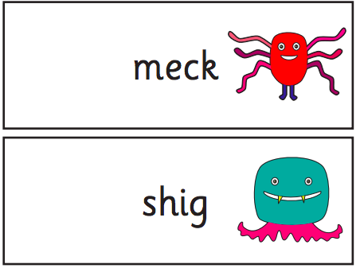
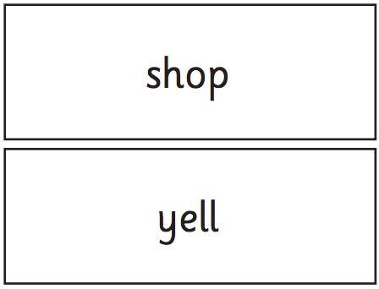
What sounds does the phonics screening check contain?
Section 1
The words in section 1 will have a variety of simple word structures using: single letters (a, b, c, d, e, f, g, h, I, j, k, l, m, n, o, p, q(u), r, s, t, u, v, w, x, y, z) some consonant digraphs (ch, ck, ff, ll, ng, sh, ss, th, zz) frequent and consistent vowel digraphs (ar, ee, oi, oo,or)
Notes:
SP

Slide 19
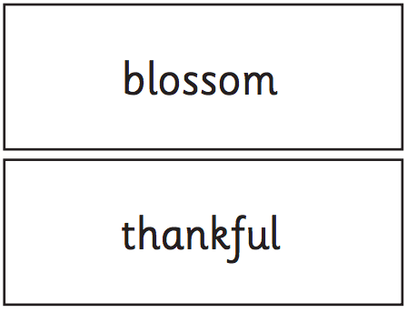
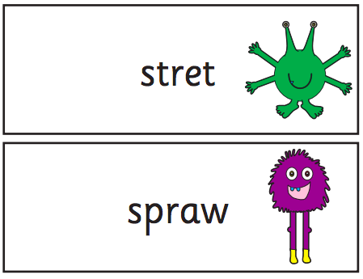
What sounds does the phonics screening check contain?
Section 2
The words in section 2 will have a variety of more complex word structures with some: additional consonant digraphs (ph, wh)
less frequent and consistent vowel digraphs, including split digraphs (a-e, ai, au, aw, ay, ea, e-e, er, ew, i-e, ie, ir, oa, o-e, ou, ow, oy, ue, u-e, ur) trigraphs (air, igh).
Notes:
SP

Slide 20






Real words and Pseudowords
In addition to a range of real words, the Phonics Screening Check includes a number of pseudowords (non-words). To allow the child to identify the word as a non-real word it is presented with a picture of an alien.
Non-words are included to check that the child is using phonics and not just using sight vocabulary to read the words.
Some children can try to make a real word and this is why we frequently practice reading pseudowords so that the children become used to reading them.
Notes:
SP

Slide 21


Real words cards
This is an example the way that the real words are presented.
Notes:
SP

Slide 22
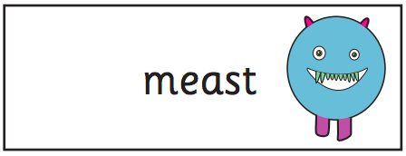

Psuedoword cards
This is an example the way that the pseudowords are presented.
Notes:
SP

Slide 23
Phonics Screening Reporting
Headteachers must report whether or not a child has met the standard by the end of the Summer term.
If your child fails to achieve the standard to pass the phonics screening check they will continue to receive support in phonics and will retake the check after 12 months in Year 2
Notes:
LP

Slide 24
How can you support your child at home?
Read their decodable books with them 4 times a week.
Complete the phonics practise uploaded onto Class Dojo each week. This will either mirror their phonics learning for the week or review previous learning. This is important because it will consolidate their learning and ensure they retain all sounds.
Notes:
LP

Slide 25
Questions

