Slide 1

Aims of the session:
To share with you the principles behind the way we teach your children spellings.
To develop a shared understanding of the importance in applying spelling strategies and knowledge
To give you ideas about how to help your child with spelling at home.
Spelling in KS2

Slide 2

Why is English so hard to learn?
Our alphabet has 26 letters.
There are 44 speech sounds.
The speech sounds can be put into 144 combinations!
The 144 combinations make up 500,000 words in common use.
However,
21 consonant letters = 24 sounds
5 vowel letters = 20 sounds!

Slide 3

don’t despair because…
However,
Although only 12% of words in English are spelt the way they sound.
85% of spelling in English is predictable!

Slide 4
Moving away from Spelling Tests
Limitations:
Written work does not reflect spelling test results;
Children become passive learners, receiving delivered knowledge and are not actively involved in the learning process;
The teaching of spelling is removed from the process of writing and is taught as a discrete skill;
Test results should not be wholly used to assess children’s spelling skill level.

Slide 5
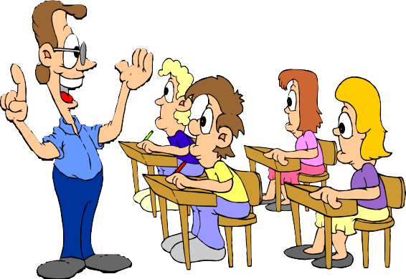
The Teaching of Spelling
Dedicated sessions thrice weekly as well as twice weekly focus in English lesson starters.
Rules, patterns and etymology should be investigated using a multi-sensory approach;
Use of Spelling Shed materials.

Slide 6
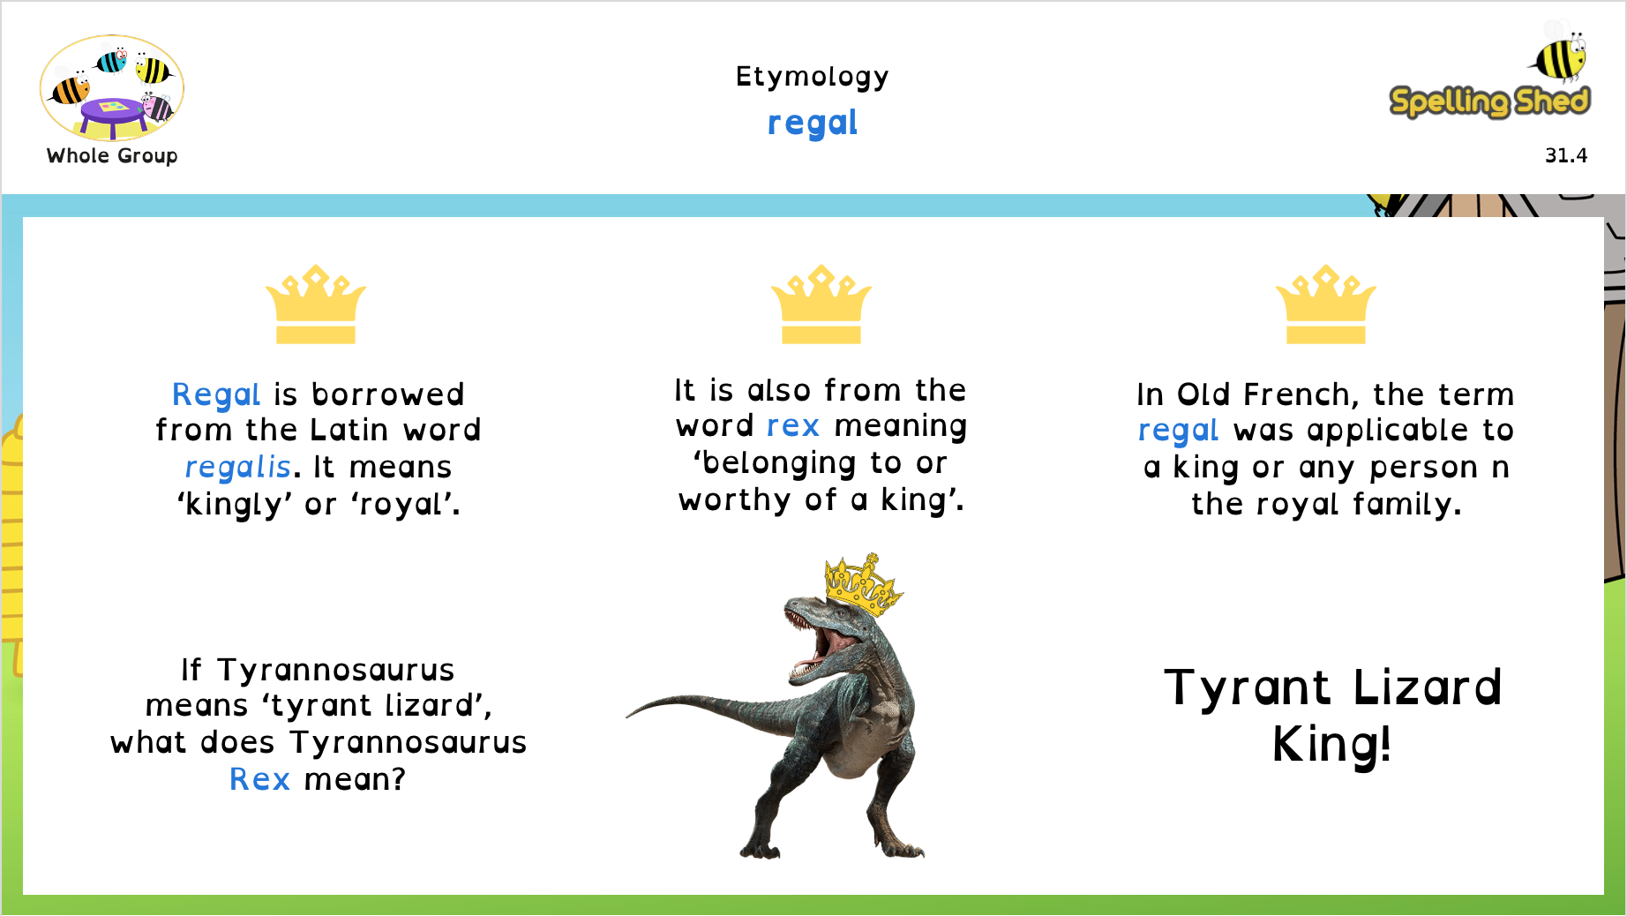

Slide 7

Graph – graphein (Greek) to write
Graphite (lead in the
Photograph Photo = light
pencils we write with)
automatic
Geography
Geo= earth
Autograph Auto = self
Calligraphy
Calli = beautiful
automobile
biography bio = life
graph

Slide 8
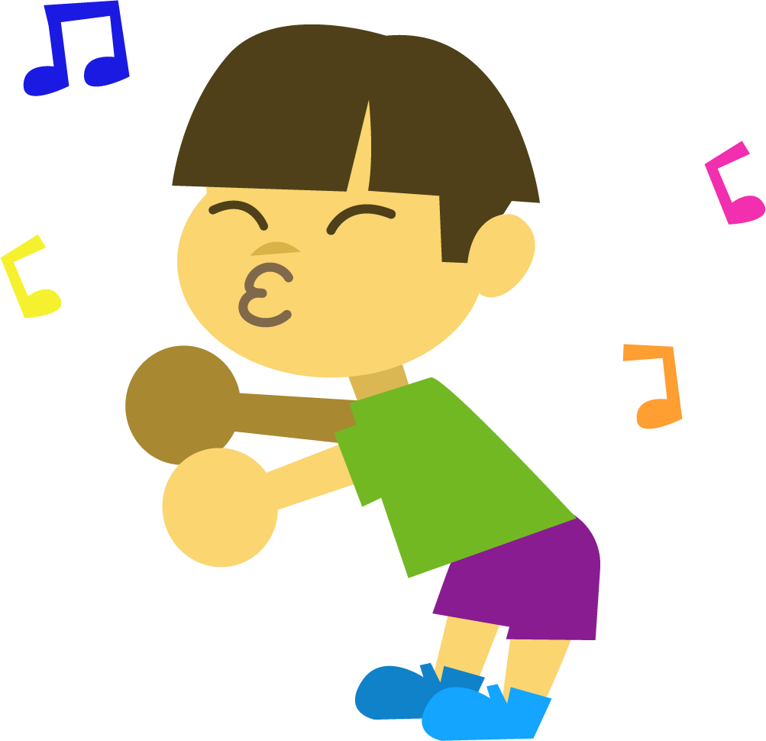
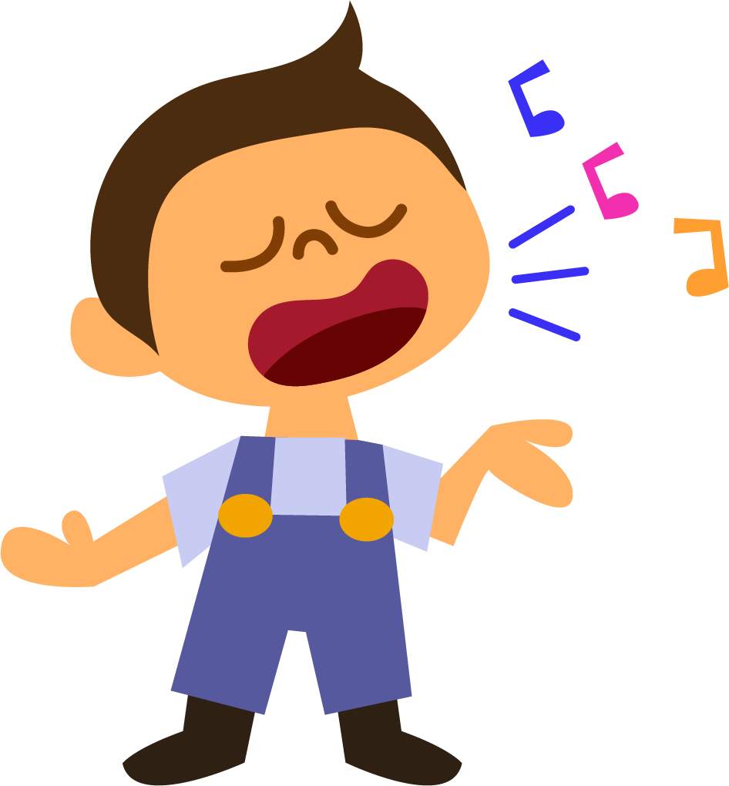
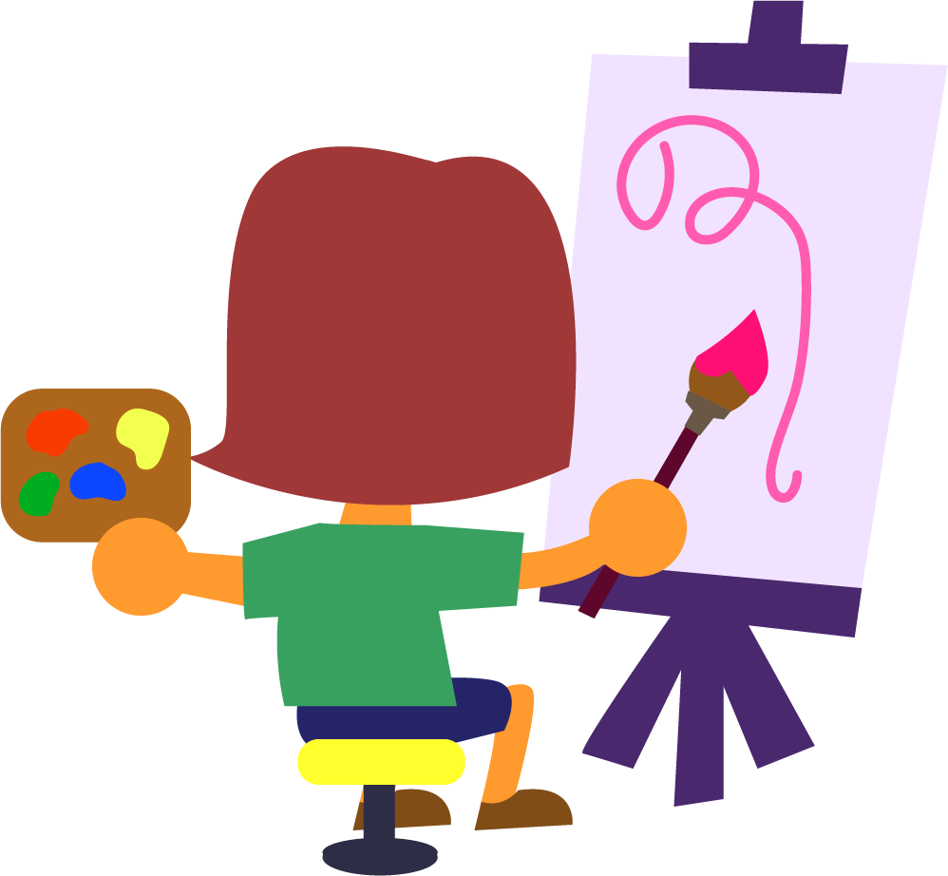
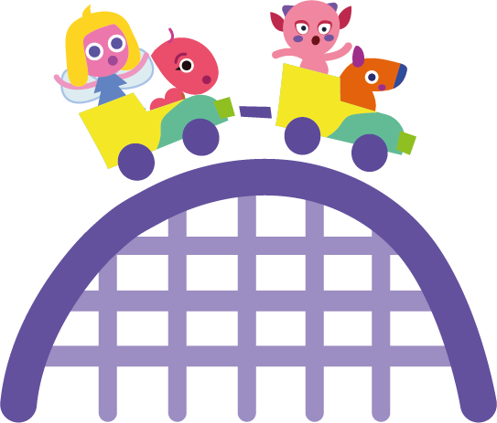
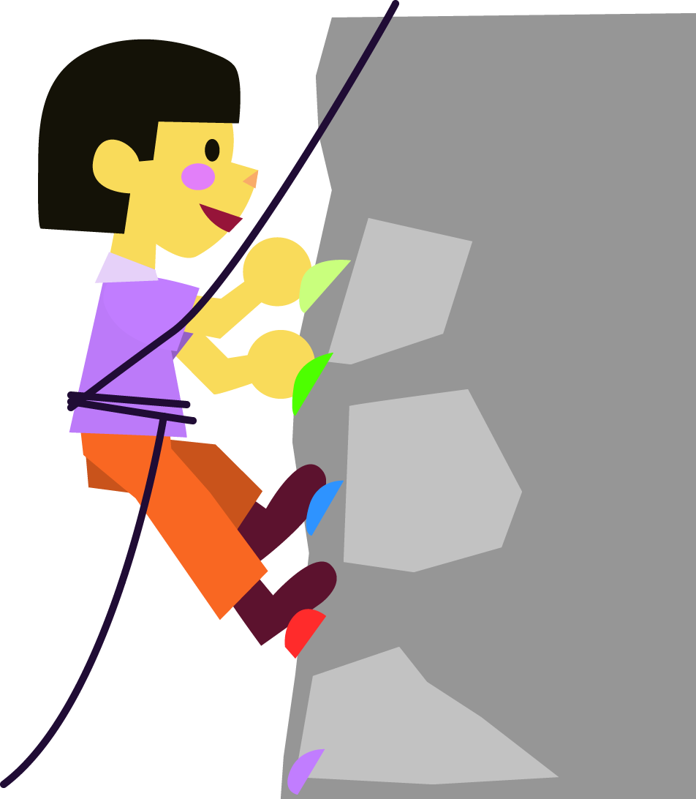
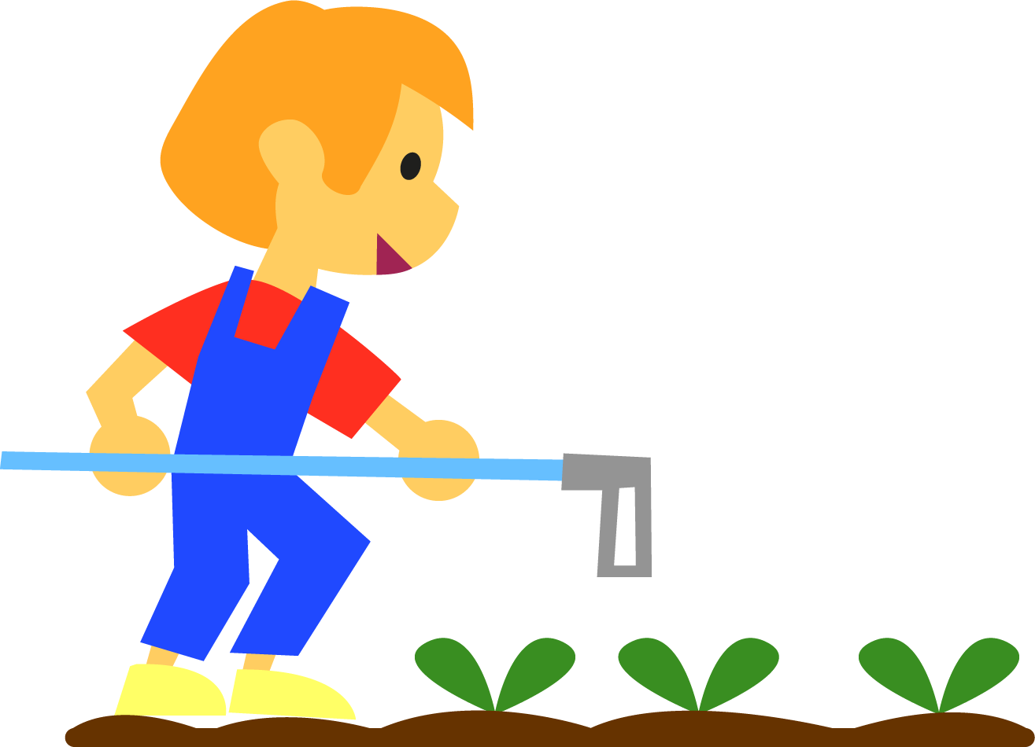
Prefixes
enjoyable
What things do you enjoy doing?
From the 1640s meaning ‘capable of being enjoyed’.
From the Old French enjoir meaning ‘to give joy, rejoice, take delight in’.
enjoyable
From the French and Old French en meaning ‘in or into’.
From the 1200s, meaning a ‘feeling of pleasure and delight’.
From Old French joie meaning ‘pleasure, delight or bliss’.
When you do something you enjoy, you’re doing it ‘in delight’.

Slide 9
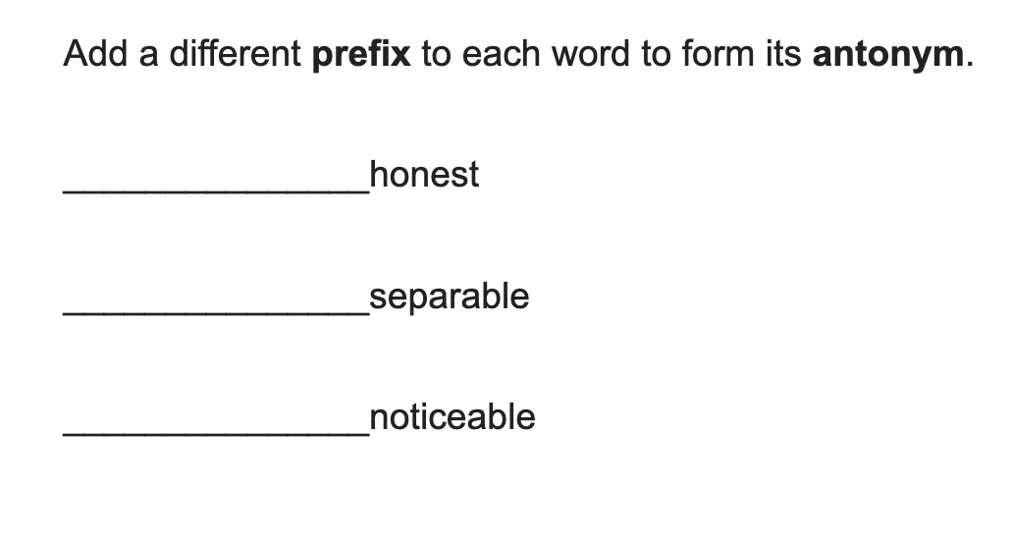
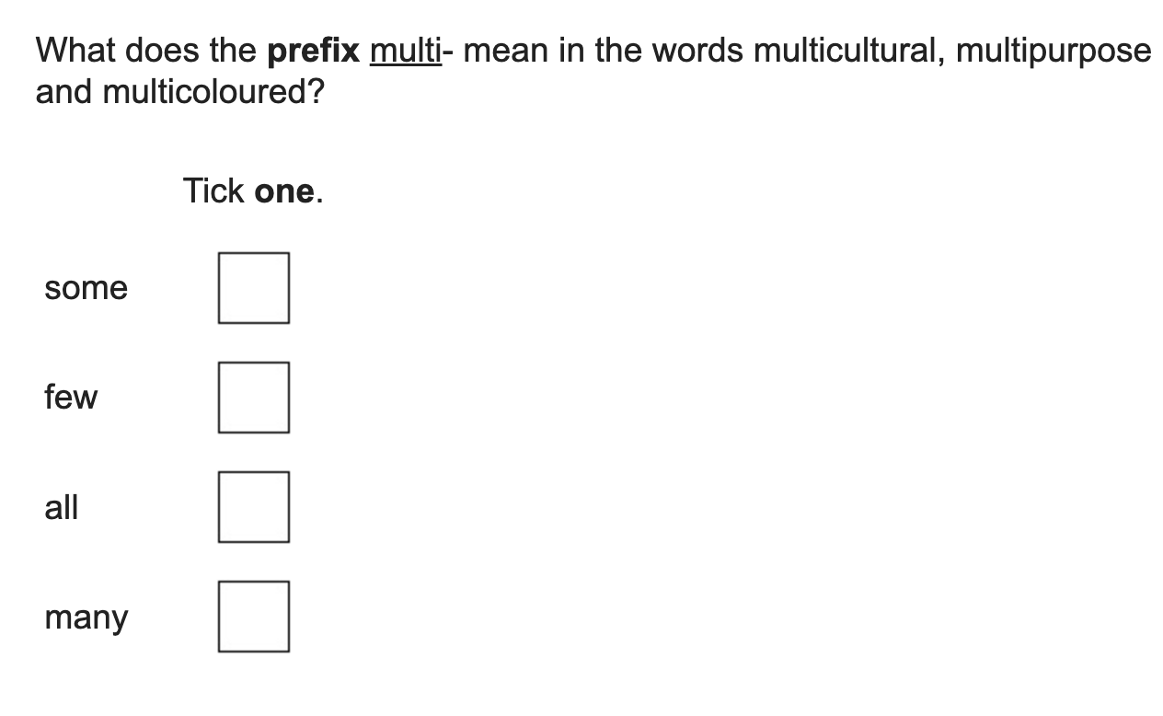

Slide 10

Understanding root words
Children need to be taught how to notice how words are built with root words, prefixes and suffixes.
This is a very important strategy, especially if your language doesn't build words this way.
uncomfortable = not comfortable = un + comfort
+ able.
irregularly = ir + regular + ly

Slide 11
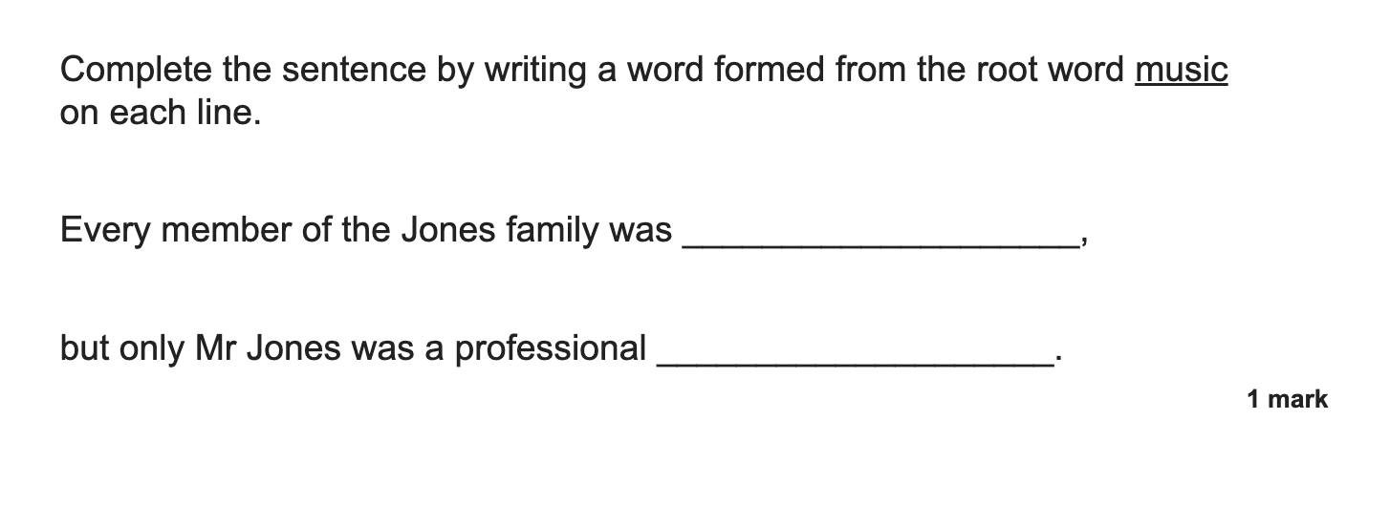
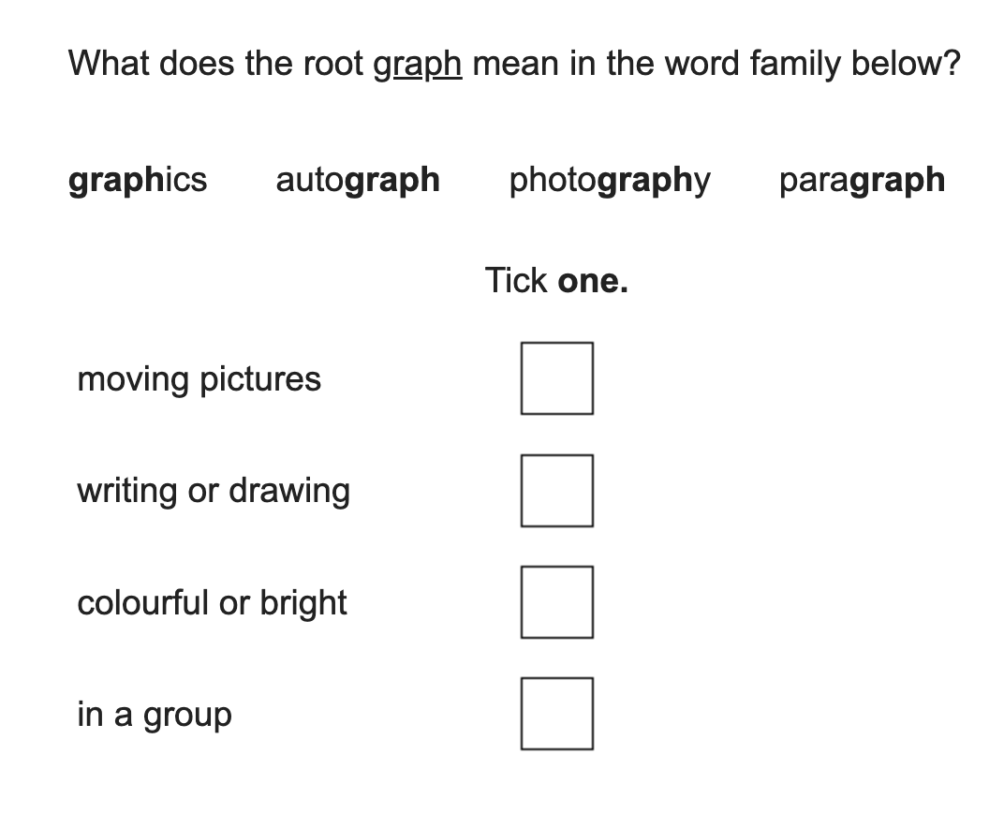
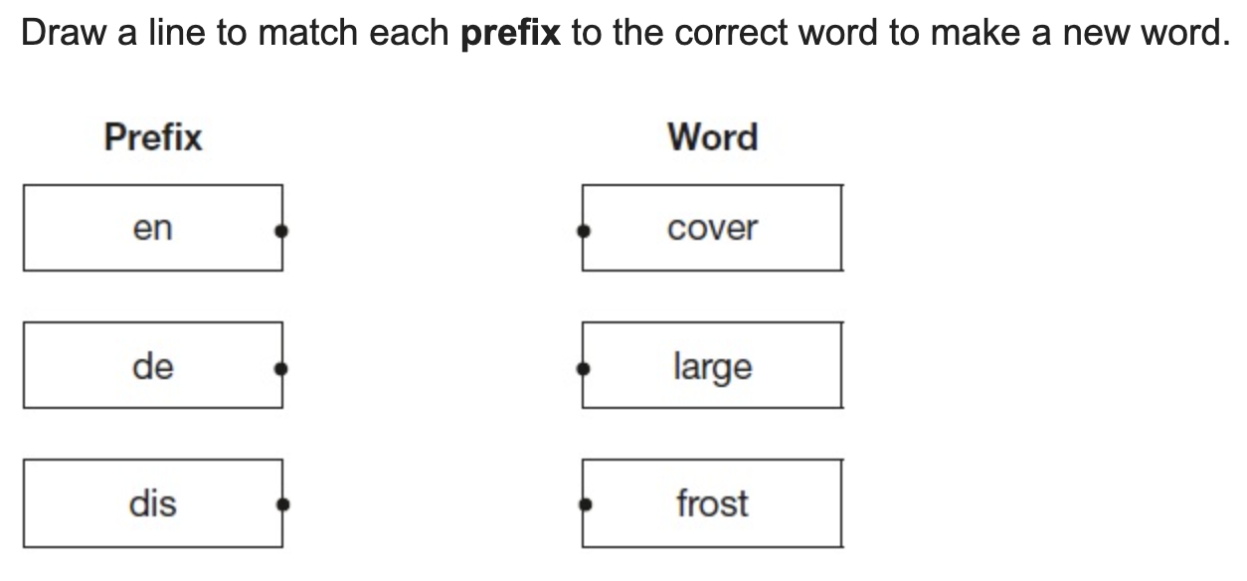

Slide 12
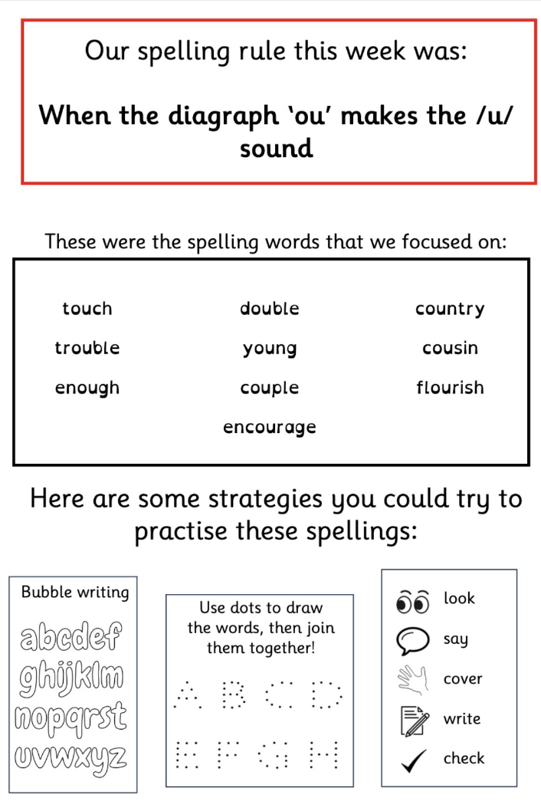
Supporting spelling at home:

Slide 13
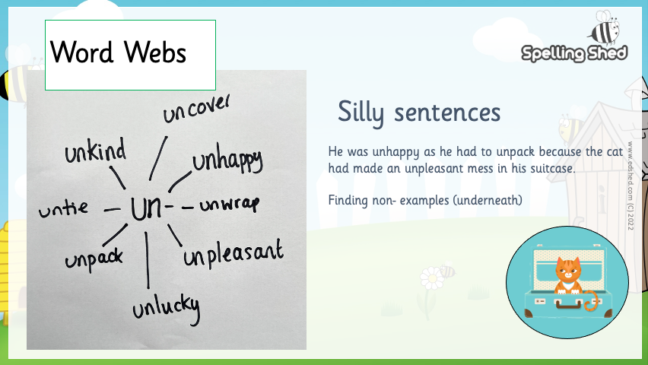

Slide 14

WORD WEBS
Word webs are likely to have more impact than dictionary work/ learning lists
biology biological
automobile automatic autocrat autograph automaton
 |  | autobiography
graph graphic graphical autograph graphological

Slide 15
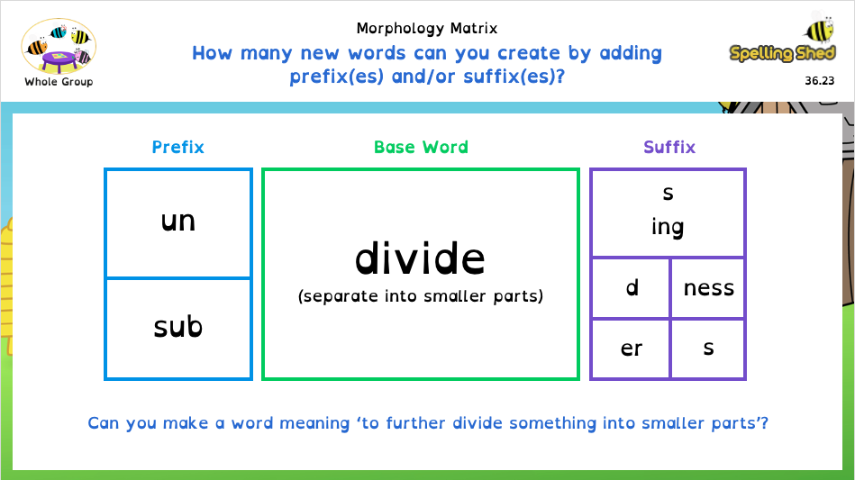

Slide 16
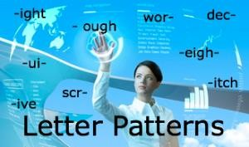
Letter patterns are a reliable way to learn spellings. Children who spot patterns are better spellers!
ight- light, bright, tight, might, flight, fight, lighter, sightseeing...
tch- match, hutch, catch, watch...
pl- play, plan, plastic, plenty, plain
spr- spring, sprung, spray, sprinkle...

Slide 17
Definition
Four other words
beginning with ‘diff’
difference
In a Sentence
Six other words ending in ‘ence’ (not this week’s words)

Slide 18
Primary Curriculum Expectations
Year 3 & 4
Revise spellings from KS1
Prefixes and suffixes
Words with endings sure, ture, tion, sion, cian
Words : eigh, ch (k), ch (sh), sci
Homophones/near-homophones:
Eg accept/except, affect/effect, ball/bawl, berry/bury,
brake/break, fair/fare, grate/great, groan/grown, here/hear, heel/heal/he’ll, knot/not, mail/male, main/mane, meat/meet, medal/meddle, missed/mist, peace/piece, plain/plane, rain/rein/reign, scene/seen, weather/whether, whose/who’s

Slide 19
Primary Curriculum Expectations
Year 5 & 6
Words with endings: cious, tious, cial, ance
Words ending in: ible, able, ably
Homophones and other words that are often confuse
Eg advice/advise device/devise licence/license practice/practise prophecy/prophesy, steal: take something that does not belong to you steel: metal wary: cautious weary: tired who’s: contraction of who is or who has whose: belonging to someone (e.g. Whose jacket is that?)

