Slide 1

Young interpreters at St. Peters

Slide 2

Young interpreters is a national scheme ran in schools designed to support children joining our school with limited English language.
These new pupils are buddied up with a YI
who is specially trained to support them
and help them to settle into St. Peters.

Slide 3
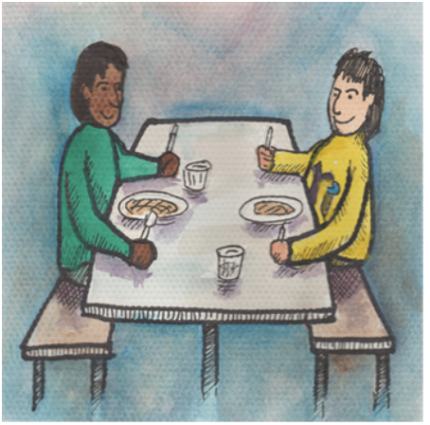
What do YI do?
YI have a range of responsibilities within school
including:
*Be a buddy to new arrivals at break and lunchtime.
*Help new arrivals settle.
*Show parents and visitors around the school.
*Demonstrate school systems and
routines.
*Promote the YI scheme and help train
others.

Slide 4
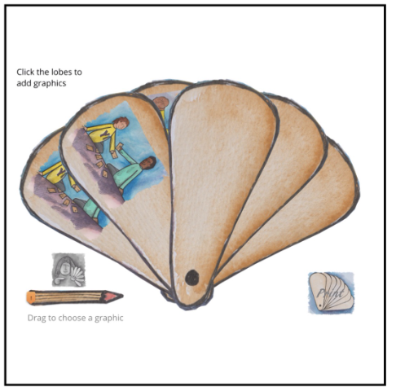
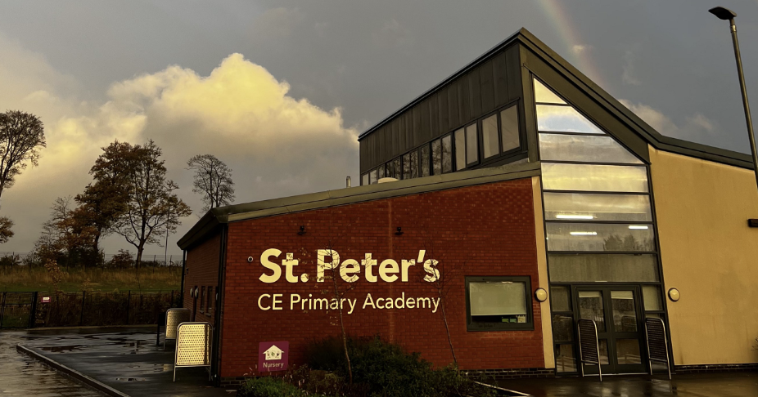
All YI receive training using special materials and are given an official role and status.
You will work with the Young Interpreter Co-Ordinator (Me) to provide peer support.
You will be buddied up with new arrivals who do not speak fluent English and will help make a difference in their time at St. Peters!
YI will also be involved in sharing what we do on the radio, SWAY and in other ways.

Slide 5


Slide 6
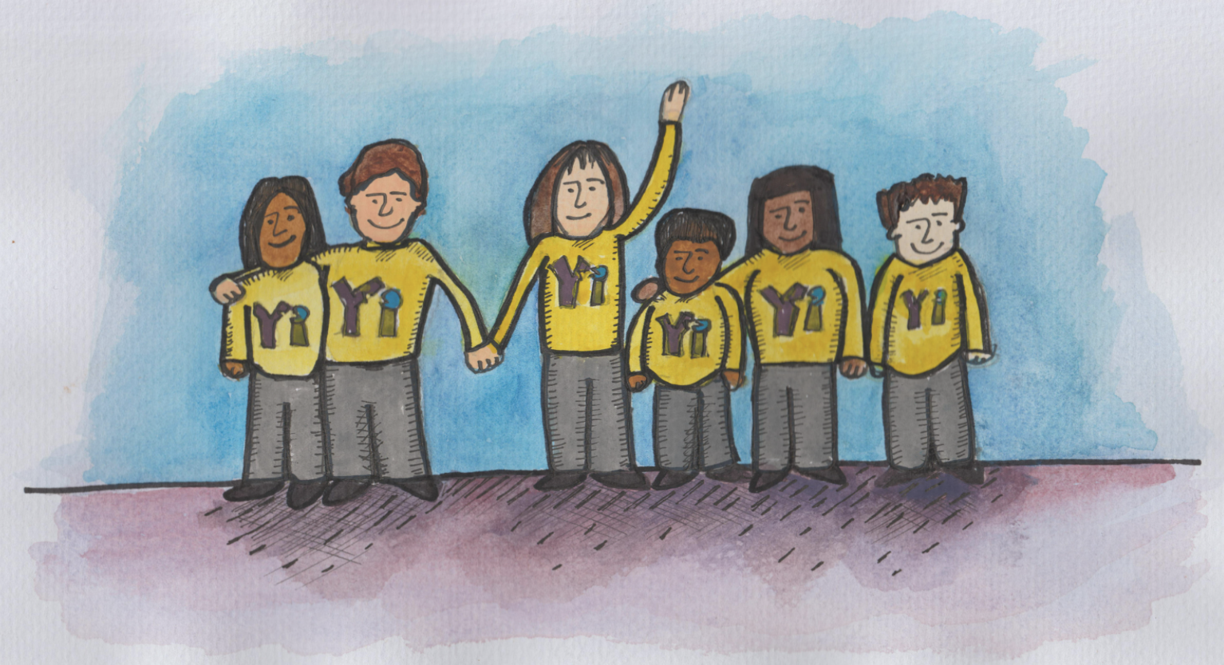
There will be 3 YI chosen from every year group in years 3-6. After half term, we will meet every Monday lunchtime for training for 5 weeks.
If you would like to become a YI, you need to sign up on the sheet in your classroom before Tuesday 20th October.

Slide 7




Any questions?

