Slide 1


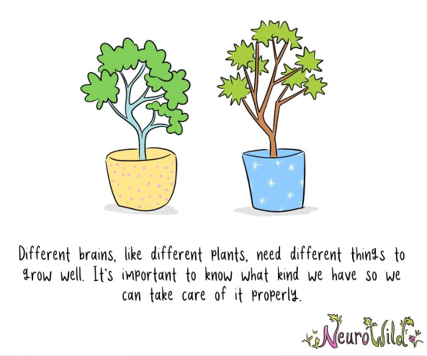


Inclusion at St Peter’s
Pupil Learning Plans
Wednesday 19th November

Slide 2
What we will cover:
St Peter’s vision and values around Inclusion
Time for questions
Rationale for change with the pupil plans in place
Pupil Learning Plans (PLPs) – information and process

Slide 3

Focus on the ‘Why’
Why?
What are our vision and values around inclusion?

Slide 4
Our Vision & Values
Early years providers, schools and colleges should know precisely where children and young people with SEN are in their learning and development. They should:
ensure decisions are informed by the insights of parents and those of children and young people themselves,
﻿﻿have high ambitions and set stretching targets for them,
﻿﻿track their progress towards these goals,
﻿﻿keep under review the additional or different provision that is made for them,
﻿﻿promote positive outcomes in the wider areas of personal and social development, and
﻿﻿ensure that the approaches used are based on the best possible evidence and are having the required impact on progress.
SEND Code of Practice 2015
In line with the SEND Code of Practice

Slide 5
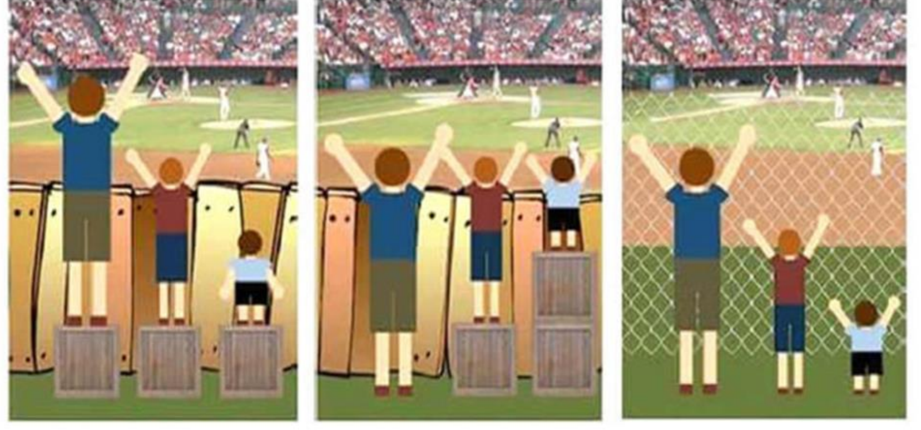
Key thoughts
What is inclusive practice?
Are we monitoring to prove something or improve something?
Ask your child- how can I help you be your best self?
Exclusion Inclusion True inclusion

Slide 6
Focus on the ‘How’
How?
Our practice, how we go about doing things

Slide 7

Your child has a PLP as he/she are on the SEND Register and have support in place at school
SEN Support– child requires something additional and / or different to the core provision and a short term graduated response has not resulted in sufficient progress.
EHCP – child requires more additional and / or different support than is available through the school’s SENS offer.

Slide 8
How: Planning for SEND
Old:
One Page Profiles
Success Plans
Support Plans
EHCPs
New:
Pupil Learning Plan – combines the above. Roadmap to achieve ambitious long-term outcomes
EHCPs

Slide 9

The Pupil Learning Plan is….
Called a Learning Plan as we need your child to learn!
It is a process, and we need to capture the process
‘a capture of a graduated response’ rather than a success plan

Slide 10
Key focus in the PLP
The Primary Area of Need has to be explicit in the PLP, and the outcomes and targets need to reflect and support the child’s identified needs.
What is the priority at the moment?

Slide 11
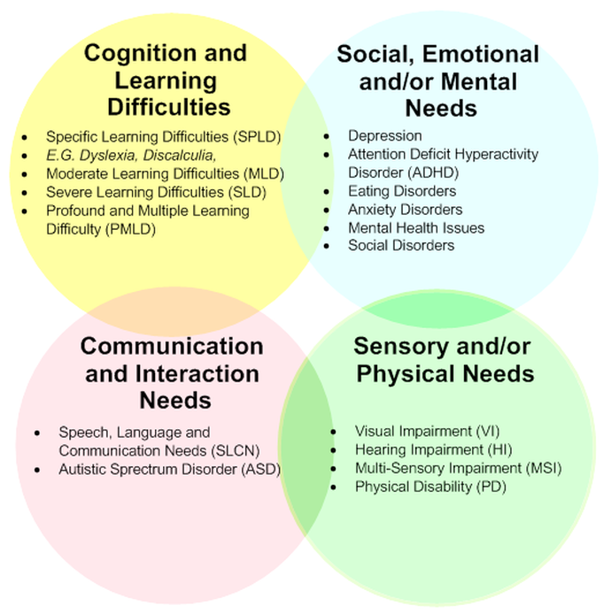
The Four Broad Areas of Need

Slide 12
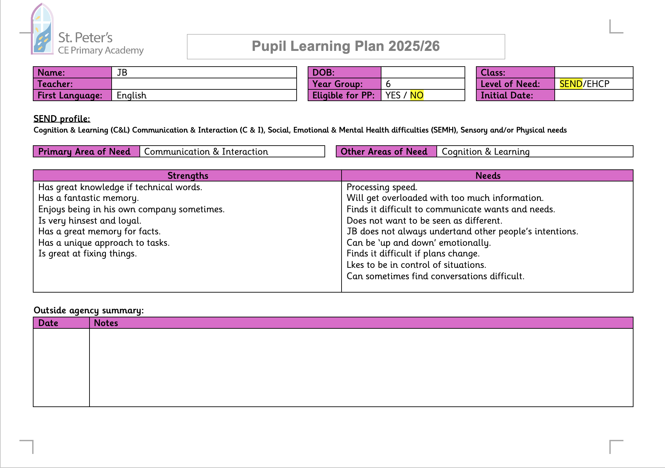
What does the PLP contain?
- Key details
- SEND profile
- Strengths and needs (based on area/s of need)
- Outside agency summary
Notes:
What is the priority?
What are the barriers to learning?
PLP – select 1 of the four AON. If there is a secondary that seems really low – raise it.
Long term outcomes – specific to what is happening at the moment/ this year
EHCP outcomes – some may be met through the Inclusive practice/ reasonable adjustments – what adults know about me part.

Slide 13
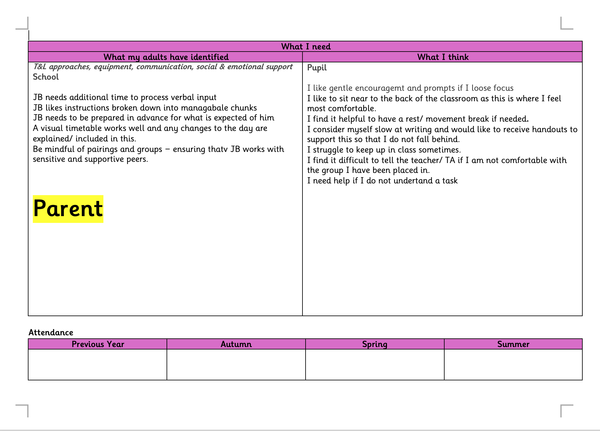
What does the PLP contain?
-What I need
(includes views of school, pupil, parent/carer)
- Attendance
Pupil voice- what they enjoy/ find difficult.
Adults have noticed - Inclusive practice - list any school approaches, reasonable adjustments, support.

Slide 14
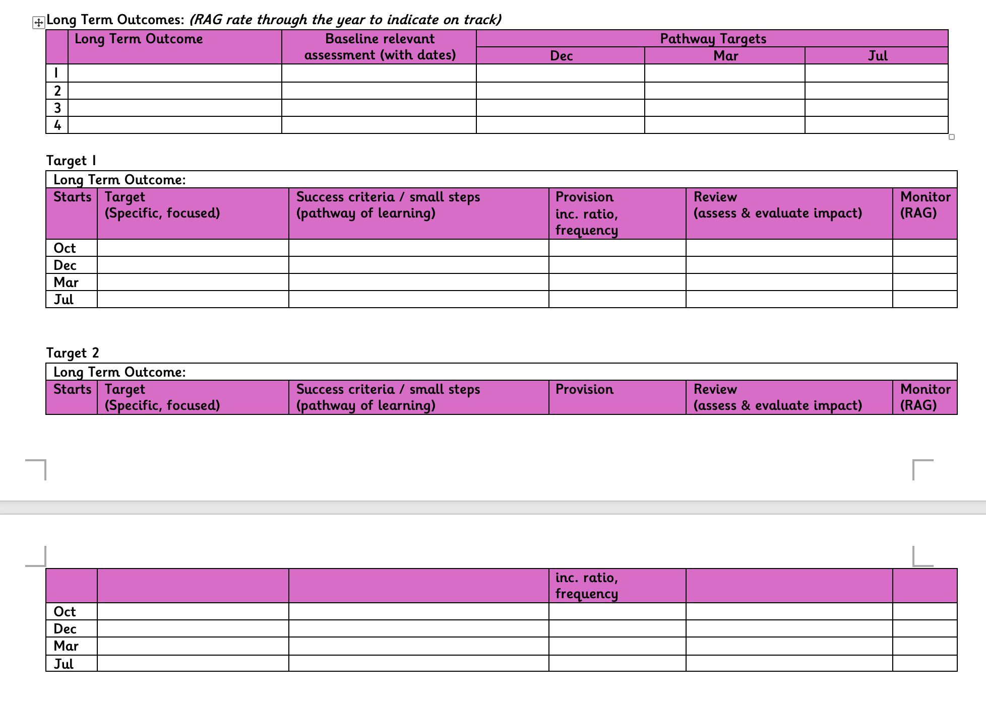
What does the PLP contain?
-Long term ambitious outcomes
(incl. what your child can do now and what we would like them to work towards)
- Broken down into 3 termly targets
- Small steps to success (to achieve those targets)
Create Outcomes which relate to need. What is the journey across the year? (There is not a minimum number)
Joined up thinking

Slide 15
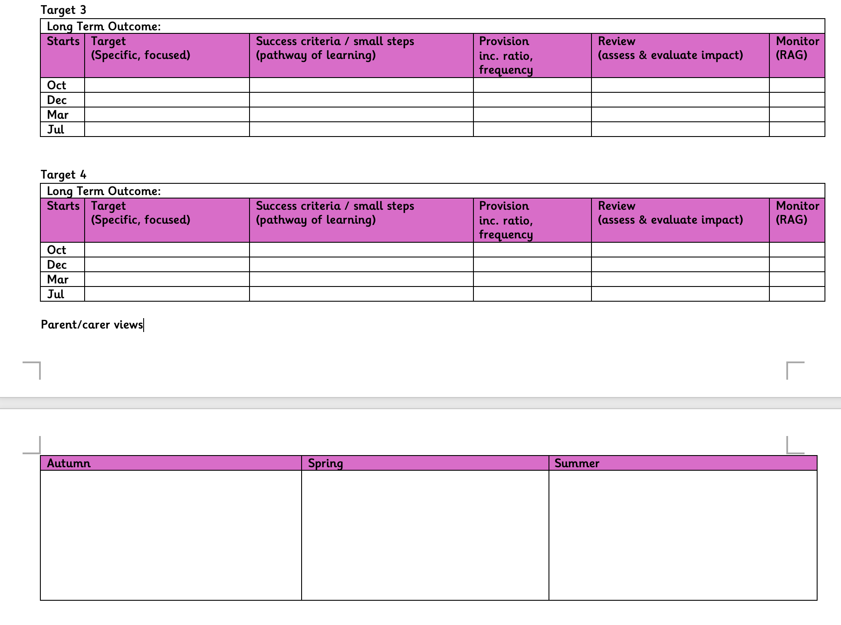
What does the PLP contain?
- Parent/ carer views (at the end of each term)
Involving parents
Code of Practice - x 3 a year.
We need to make sure we are capturing your voice too!

Slide 16
Some key thoughts…..

Slide 17

When creating targets for children with SEND it is important to remember that targets may need to be broken down into very small steps

Slide 18
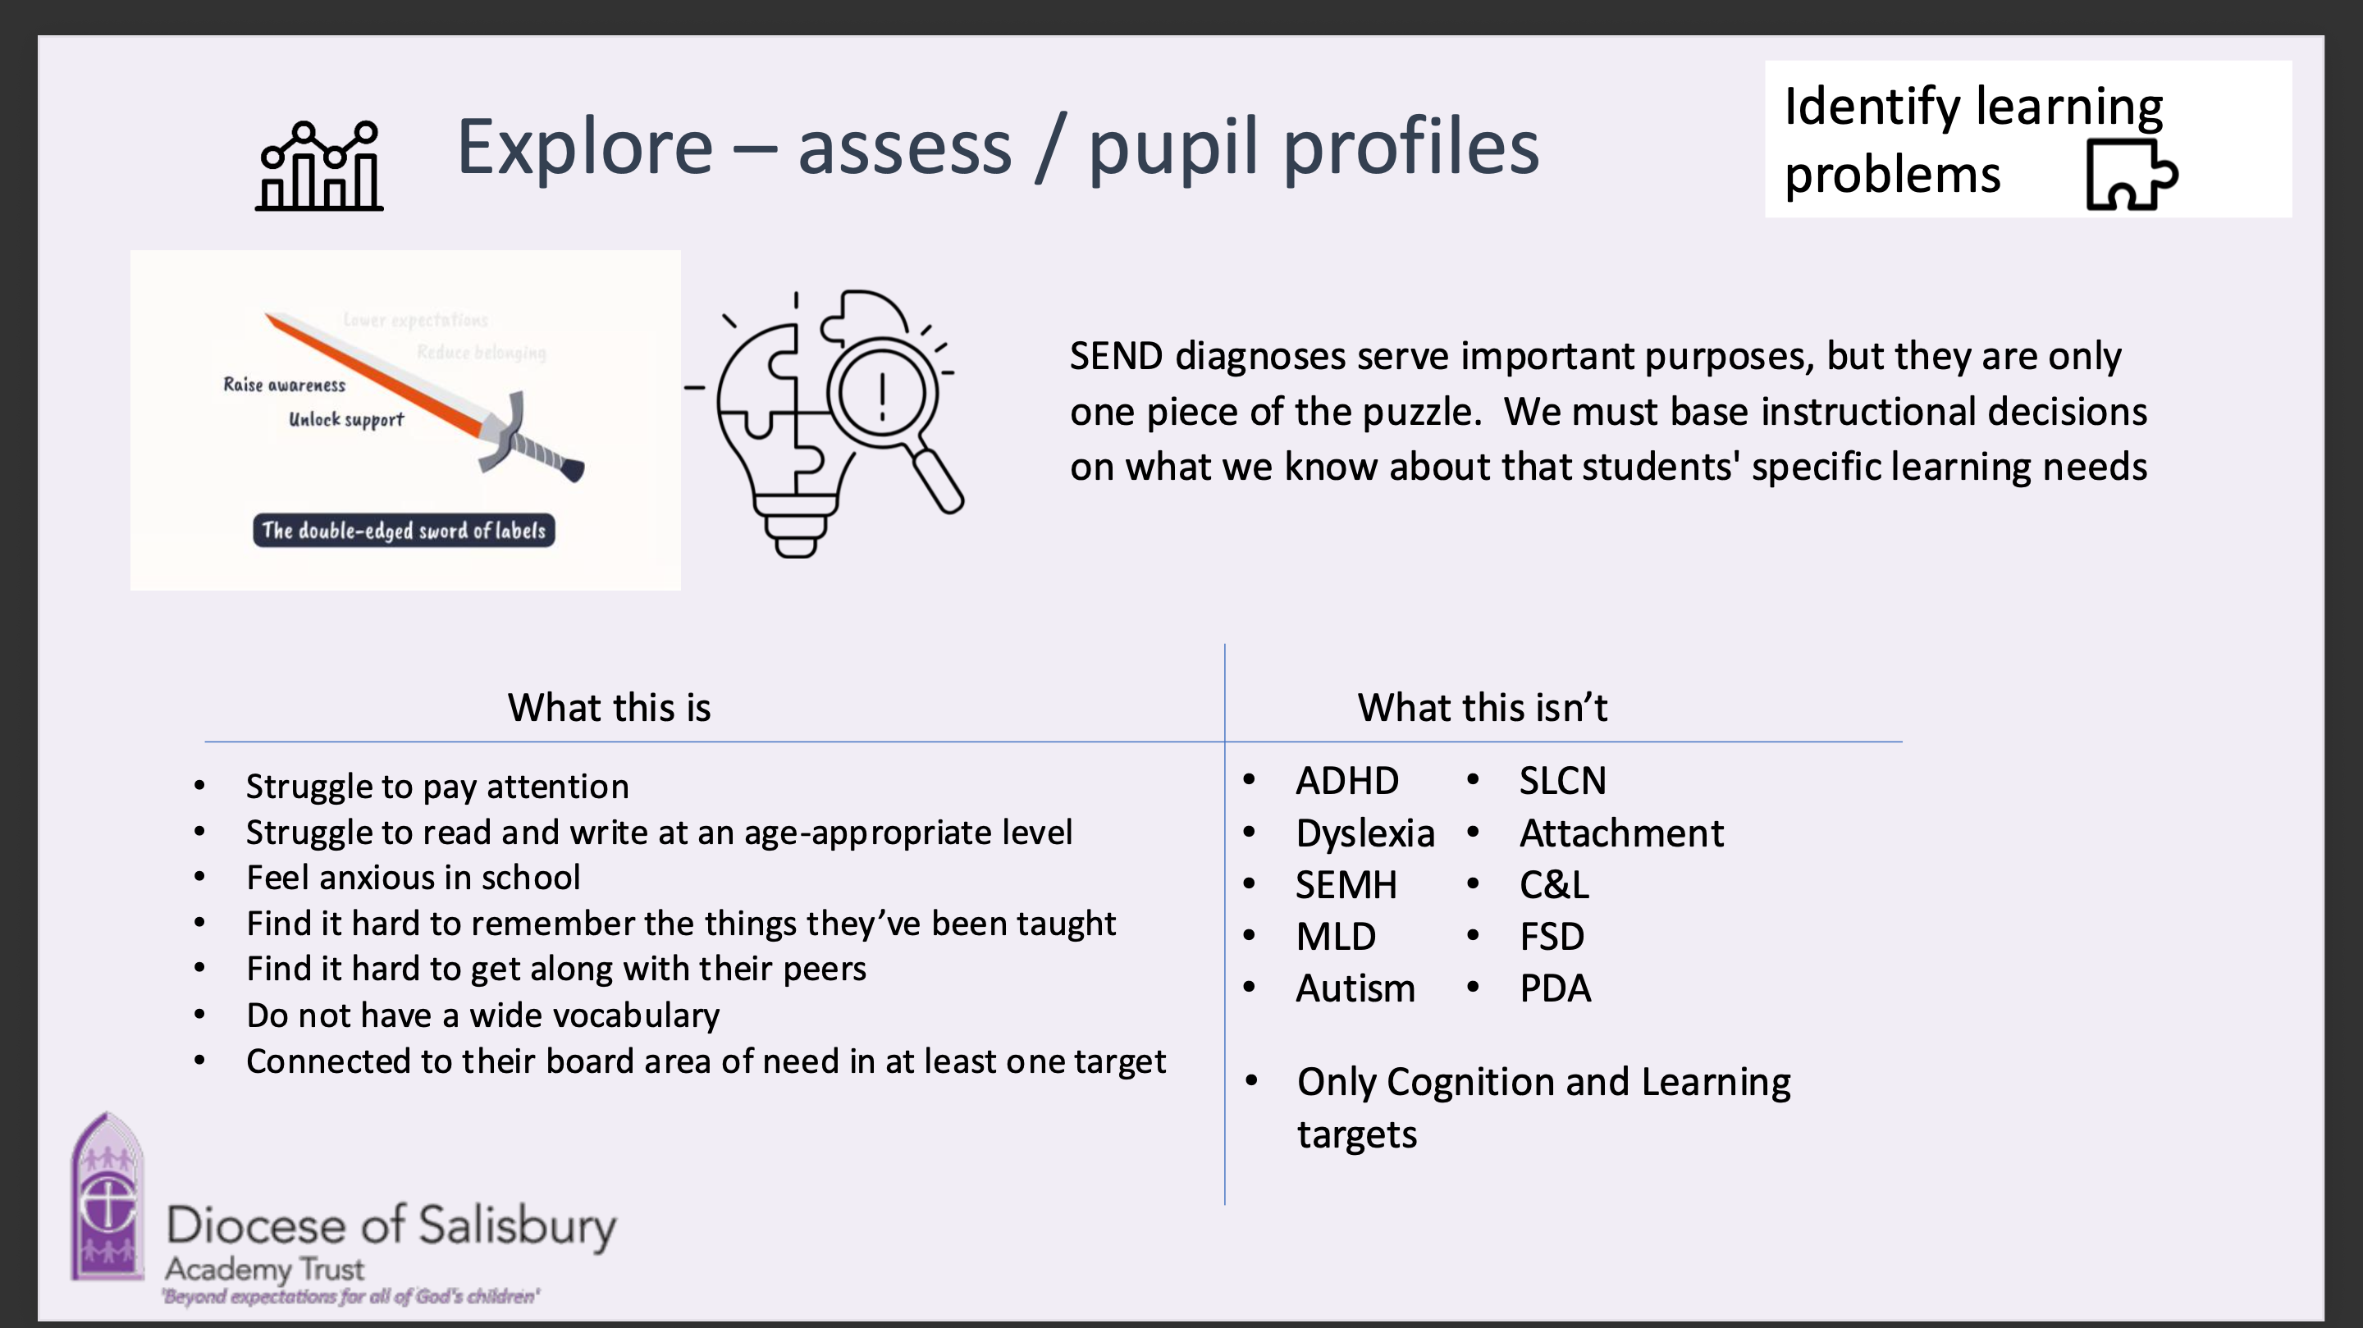
What are your child’s barriers?
Notes:
SEND diagnosis serve part of the puzzle.
Need to move away from diagnosis/ label language.
Labels – do unlock support and raise awareness but can lower expectations and reduce belonging.

Slide 19
Key Dates which teachers are following:
October/ November : Add child’s and parents’ contribution to PLP.
December: 1st – 15th review PLPs and update with small steps for Spring term (This year, we are using an inset day in January so it will be slightly later)
February:
Review the targets informally
At Parents’ Evening, add Spring parents’ bottom comment to PLP.
March: 16th – 30th review PLP and update with small steps for Summer term
July: 1st – 10th review PLP. Write interim targets for next teacher. Use optional Parents’ Evening to add Summer parents’ bottom comment to PLP. Provide parents with a copy.
July: transition to next teacher
(You will receive a copy of the updated PLP at THREE strategic points during the year.)

Slide 20

Thank you for listening ☺
Any questions?

