Slide 1

ELS Spelling Parent Workshop
11 November

Slide 2
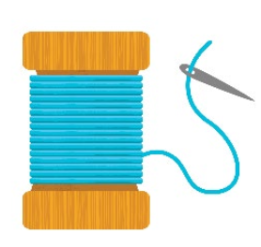
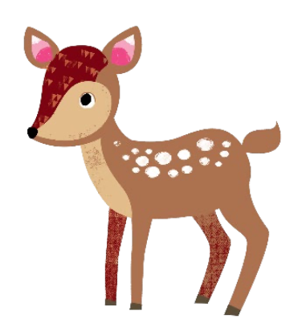
What are we going to cover?
What is ELS Spelling?
ELS Spelling Coverage in Year 2
How we teach spellings?
The Spelling Sequence
Supporting your child with spelling at home

Slide 3
Quick reminder!
ELS – Essential Letters and Sounds
Phoneme: The smallest single identifiable sound in a word. E.g. In the word ‘cat’ there are three phonemes c/a/t.
Grapheme: The written representation of a sound.
Digraph: Two letters making one sound. E.g. /sh/ in the word ‘shop’.
Trigraph: Three letters making one sound. E.g. /igh/ in the word ‘night’.
Split Digraph: Two vowel letters split but are split by one or more consonants. E.g. /a-e/ in the word ‘cake’.

Slide 4
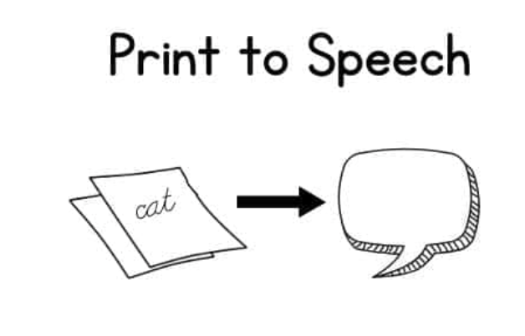
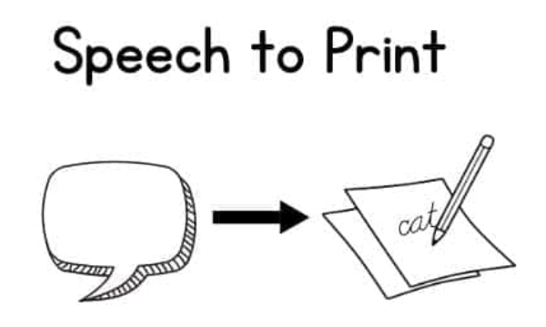
What is ELS Spelling?
Essential Letters and Sounds Spelling (ELS) is our chosen spelling programme which is designed to help children spell with confidence and accuracy.
It directly builds on ELS Phonics which children have been learning through since EYFS.
It is designed to support children in making the transition from decoding to encoding
Encoding:
Spelling by building words from the sounds children hear
Decoding:
Reading by breaking down print into sounds

Slide 5






What is ELS Spelling?
There are 44 main sounds (phonemes) in the English Language but over 200 different ways to spell these sounds (graphemes)
Spelling through ELS encourages children to make links between sounds and spelling patterns e.g. children know ‘ai’, ‘ay’, ‘a-e’, ‘a’, ‘ey’ and ‘ea’ all can make the ‘a’ sound and we practice using each one in context and where it is found in a word. This helps to support and develop accuracy when writing
Which sound to pick?

Slide 6
ELS Spelling Coverage in Year 2
Children are introduced to:
Revisiting alternative sounds from Year 1 (Autumn 1 and 2)
Common spelling patterns and rules e.g. adding –ed, -er, -ing (Spring)
High frequency words and exception e.g words that don’t follow the rules!
Morphology – prefixes and suffixes (-tion, -ment, -ly, –ful, -less, -ness)
Homophones
Apostrophes (contraction and possession)
Builds throughout the year by starting with simpler patterns
This matches the Year 2 National Curriculum expectations

Slide 7

How do we teach spelling?
We use a simple, consistent approach to teaching spellings
There are 3 spelling sessions per week that follow a similar structure
Each session follows the structure of: Teach, Practice, Apply
Your child will experience the same classroom routines within each lesson which reduces cognitive load and maximises the chances of success.

Slide 8
How do we teach spelling? – Taught not tested!
Traditional Approach
Children are given a list of words on Monday.
They practise at home, often by rote memorisation.
They take a spelling test on Friday.
Children tend to forget as this is isolated

Slide 9
How do we teach spelling? – Taught not tested!
Spelling through ELS
Each week focusses on a new sound or rule
Children learn the rule, practice using it and apply either through sentence writing or activities in ELS Spelling books.
Encouraged to understand how spelling works rather than just memorisation
Explore how words are spelt through a variety of activities: spot the rule/sound, spellchecker, sorting games
Practice happens little, often and rules and sounds are revisited as well as woven into English curriculum so children see the link.
Teachers guide children to notice patterns and exceptions

Slide 10



The Spelling Sequence
Like in Year 1, children use the spelling sequence to support them with their spelling and writing. Children practise orally and then have the opportunity to write 3words using the rule
You can use the spelling sequence with your children at home to support them with their writing.
Let’s try this with the word: tiger.

Slide 11
The Spelling Sequence
Say it!
Tiger ,Tiger, Tiger
Could use different volumes, expression etc.
Stretch it!
Tiiiiiiiigerrrrrr
Blending hands:
Blend into the whole word - tiger
Count the sounds:
Count each sound on fingers - t-i-g-er
What’s the word?:
Say the word again.
Robot Arms:
T- I- G –ER
Move one arm for each sound

Slide 12
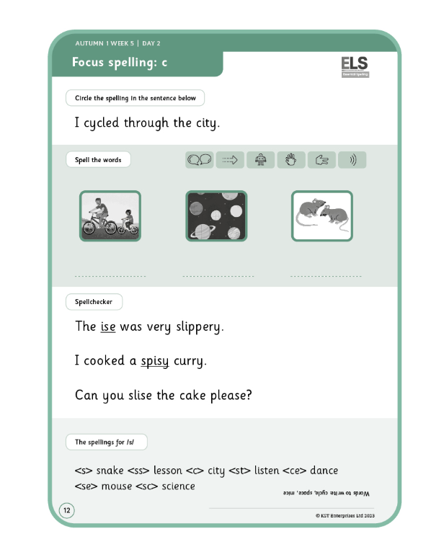
How do we teach spelling?
Teach, Practice, Apply
Children often complete a page in their spelling book to consolidate learning from the session.
Similar activities are seen in the lesson.
Activities are scaffolded to support all learners to be successful

Slide 13

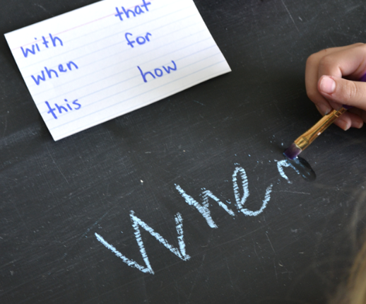

Supporting your child with spelling at home
Dojo home learning – each week the spelling activities cover what children have learnt that week. This will support children with consolidation and retention. Your child will now have a spelling book to practise writing the words covered in for homework to support with handwriting.
Make spelling fun! –Children could write them in chalk, sand, shaving foam, magnetic letters, rainbow writing
Look, Say, Cover, Write, Check! – helps to identify particular words they find difficult and keep practicing them.
Spotting spelling patterns – can children find it in their school reading book or other books they read? Road signs?
Notes:
Keep it light, fun – little and often is best!

Slide 14
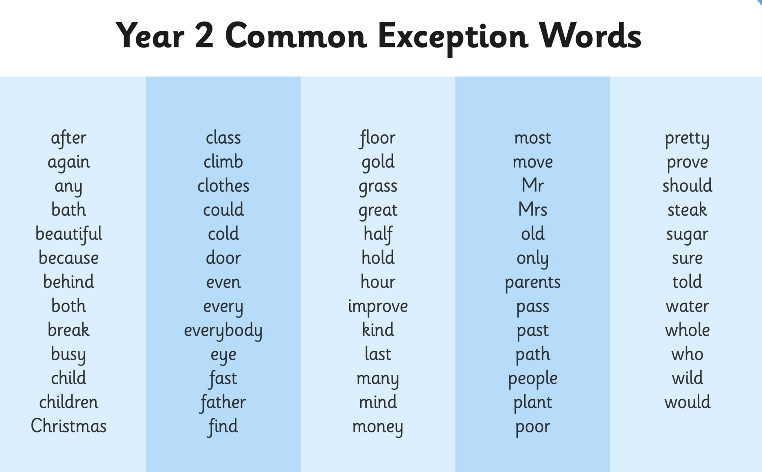
Year 2 CEW
Spelling and Reading these words by END of Year 2
Integrate into Spelling homework sentence writing

Slide 15
Questions

