Slide 1
Number Sense Workshop
“Pure Mathematics is, in its way, the poetry of logical ideas.”
Albert Einstein

Slide 2
What are we going to cover?
What is Number Sense?
Year 3 coverage
Year 4 coverage
Daily Times Table Fluency Sessions
Ways to teach times table knowledge
Year 4 Multiplication Table Test (MTC)
How can you help at home?
Notes:
LP

Slide 3
Why are timetables so important?
Notes:
LP

Slide 4
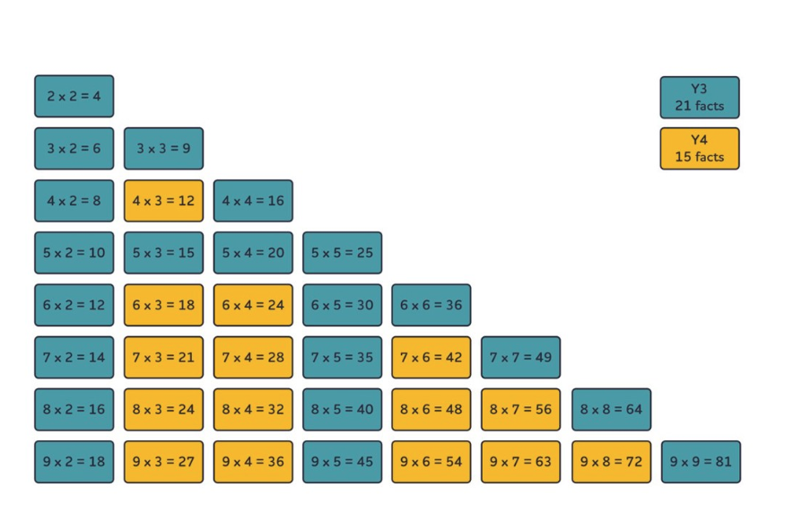
What is Number Sense?
The Number Sense programme builds a deep understanding of number and number relationships.
In year 3 and 4 the children will follow the Times Table Fluency programme. This programme develops the recall of 36 core multiplication facts. Fluency in these facts provides the foundation for all written and mental multiplication and division.

Slide 5
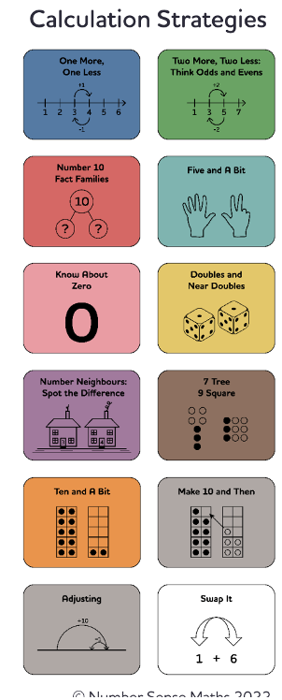
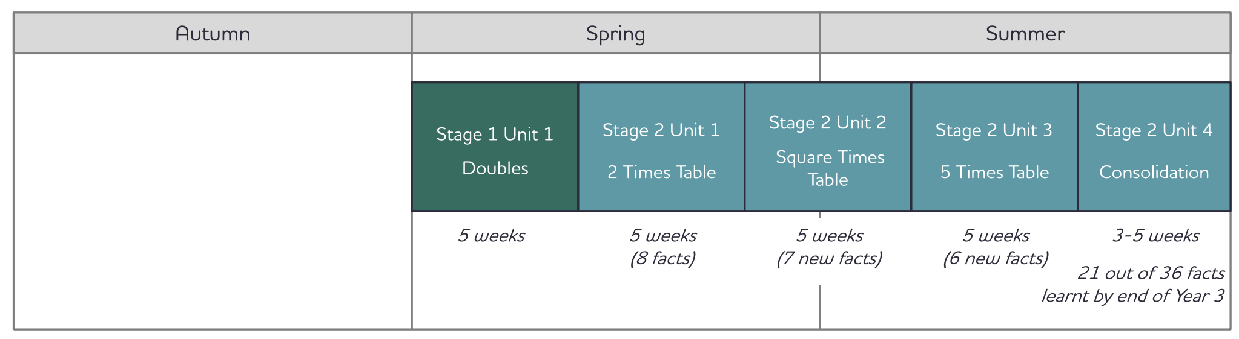
Year 3 Coverage
During Autumn term children in year 3 will consolidate their learning from the KS1 programme. This programme focuses on teaching the children a core set of number facts and the calculation strategies used to solve them

Slide 6
Year 3 Coverage
From Spring, all children will move onto the times table Number Sense programme. They will start by looking at their doubles, 2x, 5x and square numbers. In year 3 the children will have learnt 21 out of 36 of the core facts.

Slide 7
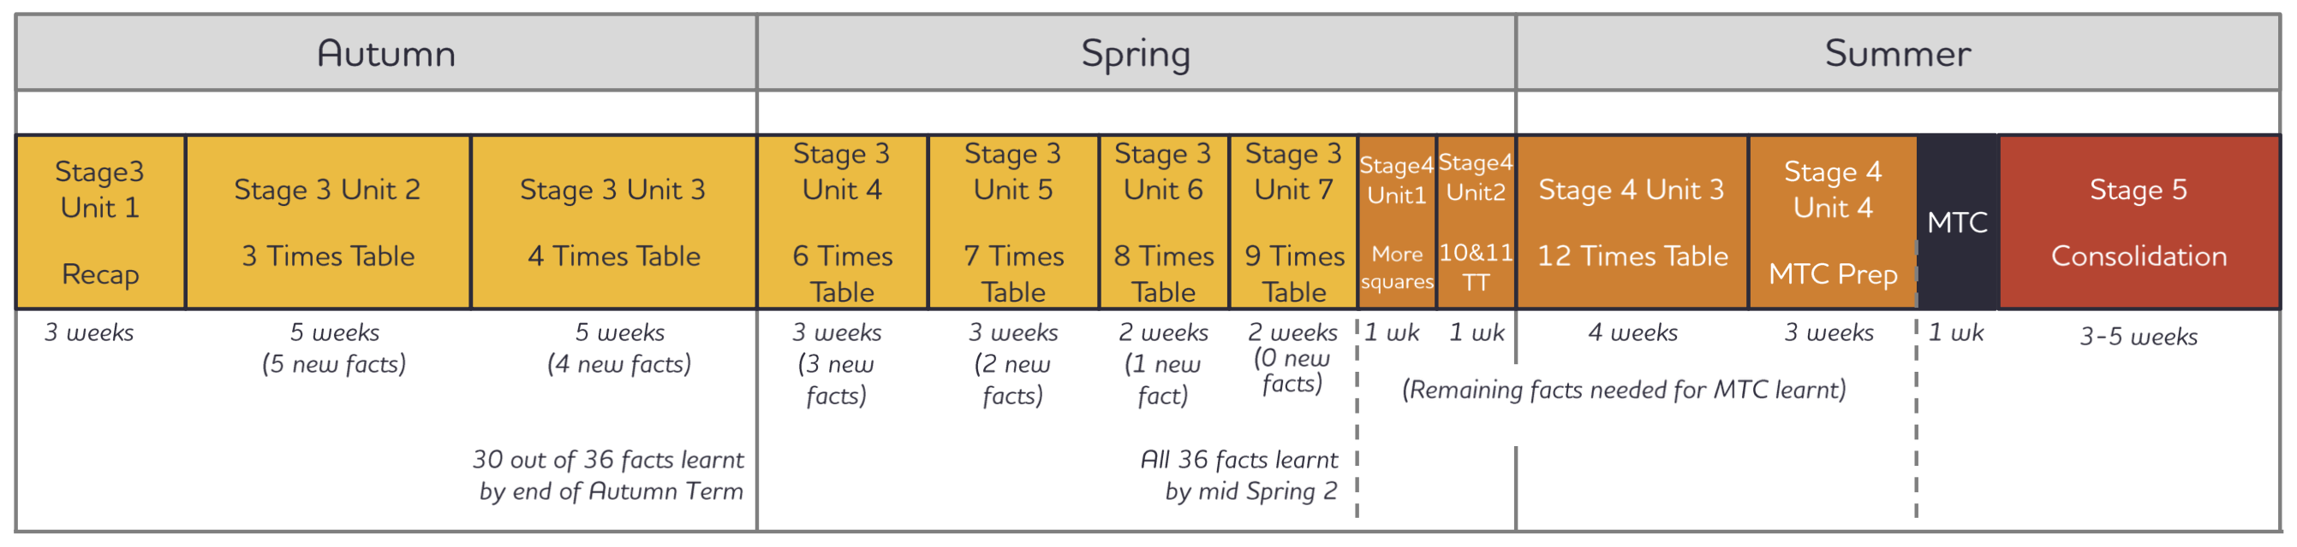
Year 4 Coverage
In year 4, the children will then learn the remaining 14 core facts. By the middle of Spring 2, the children will have learnt all 36 core facts. Then they will learn the 10,11 and 12 times tables in preparation for their Multiplication Tables Check (MTC).

Slide 8
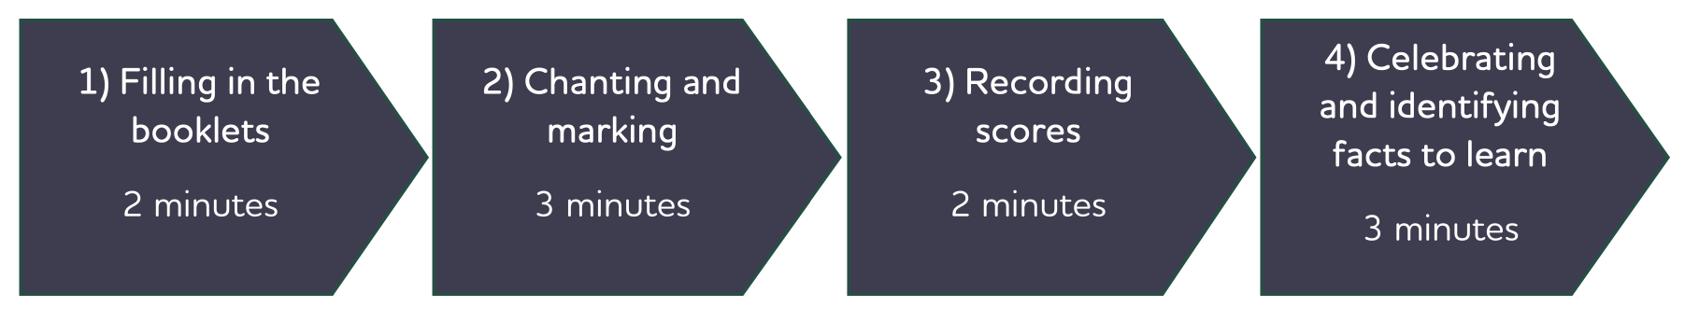
Daily Times Table Fluency Sessions

Slide 9
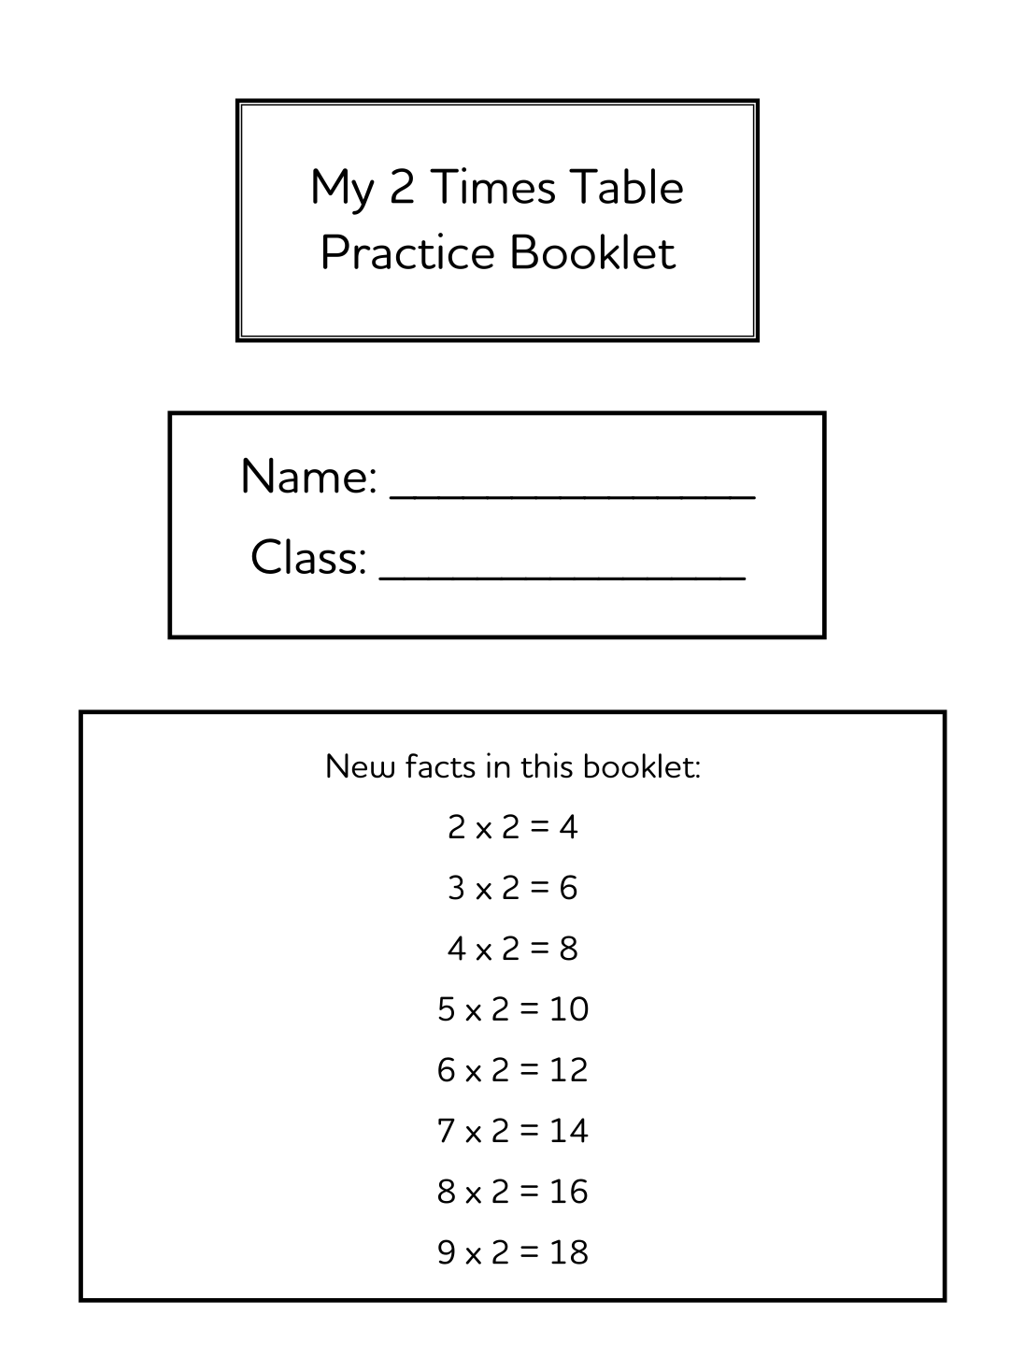
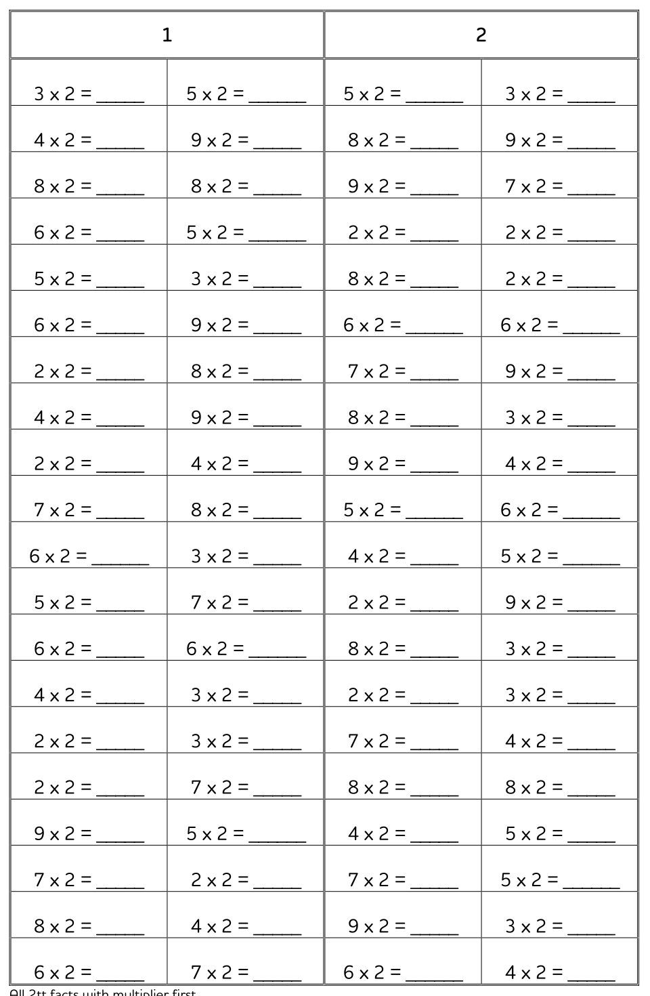
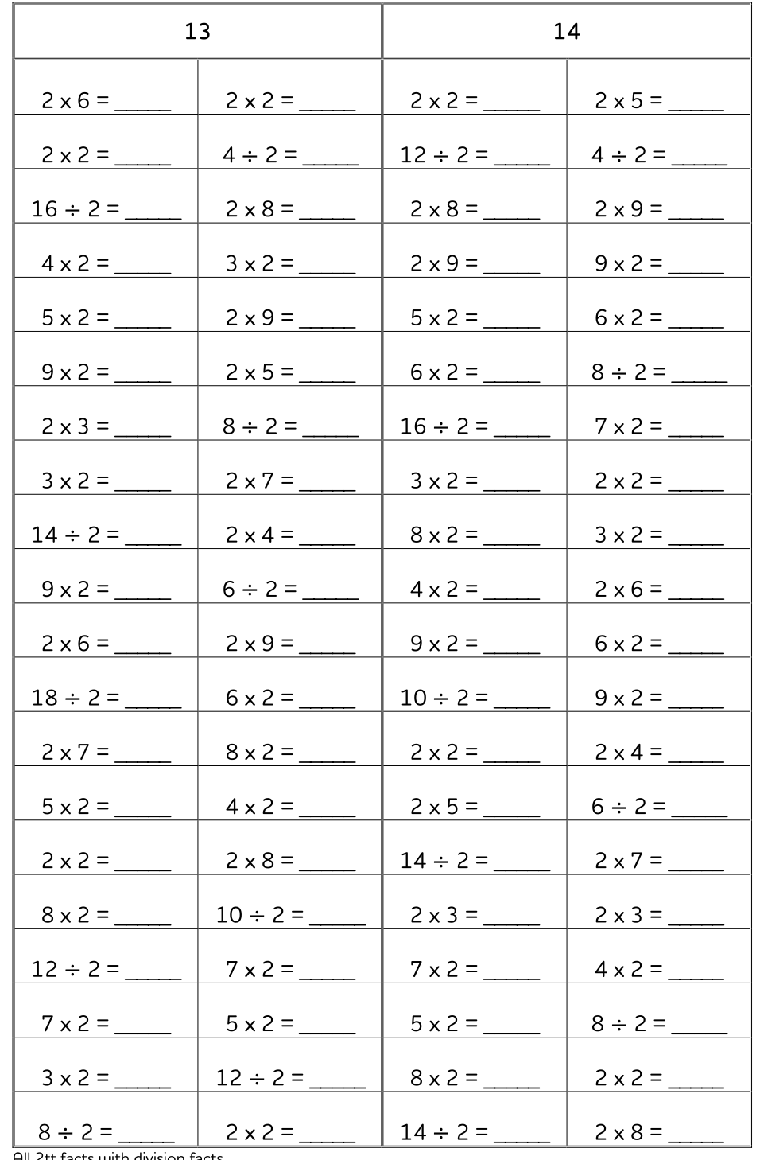
Daily Times Table Fluency Sessions

Slide 10
Ways to teach times table knowledge
Count and look for patterns.
Understand that multiplication is repeated addition.
Remember that multiplication is commutative.
Remember that multiplication is the inverse of division.
Recall and utilise number families.

Slide 11

Counting and looking for patterns
Example: Counting in 2s
2, 4, 6, 8, 10…
Ensure children have a strong understanding of counting in groups first.
When children are secure with counting, they can then look for patterns.

Slide 12
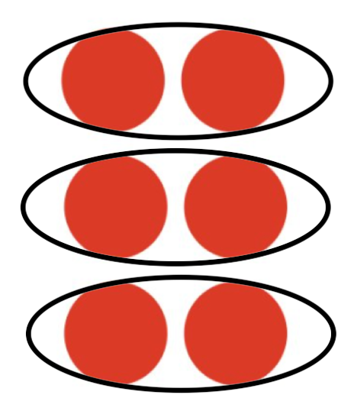

Repeated Addition
I know 2 + 2 + 2 = 6, then I know 3 x 2 = 6
2 + 2 + 2 = 3 x 2

Slide 13
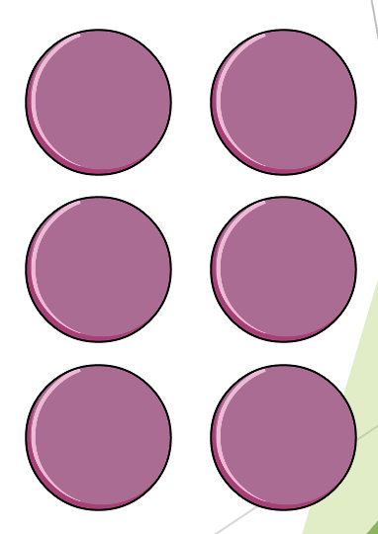
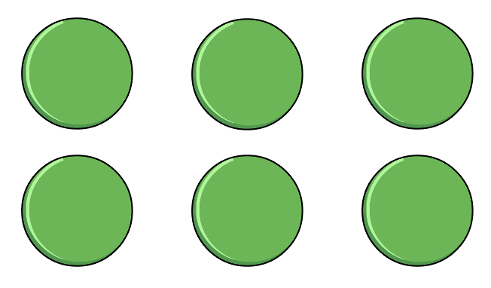
Multiplication is Commutative
3 x 2 is the same as 2 x 3
2 lots of 3
3 lots of 2
Children need to understand that multiplication can be completed in any order to produce the same answer. Sometimes this link needs to be made explicit.

Slide 14
Multiplication is the inverse of division
If I know
3 x 2 = 6
2 x 3 = 6
Then I know…
6 ÷ 3 = 2
6 ÷ 2 = 3
These links will be highlighted throughout the programme and children will be expected to use their multiplication facts to answer division facts.

Slide 15

Using Known Facts
4 x 6 = ?
I know 4 x 5 = 20
Therefore, 20 + 4 = 24
By using known facts from ‘easier’ times tables, children should be able to find answers with increasing speed.
+

Slide 16
Multiplication Table Check (MTC)
The MTC determines if Year 4 children can fluently recall their multiplication tables.
They are designed to help schools identify which children require more support to learn their times tables.
There is no ‘pass’ rate or threshold which means that, unlike the Phonics Screening Check, children will not be expected to re-sit the check. As a school, we consider 21/25 a ‘pass’.
Notes:
85% - 21 or above (pass)
53% - 25/25 – national average – 39% ‘well above average’.

Slide 17
Multiplication Table Check (MTC)
Schools must administer the multiplication tables check within the 2-week period from Monday 1st June 2026.
Pupils can use the ‘try it out’ check from around a month beforehand to familiarise themselves with the format, including any access arrangements, before taking the official check. The ‘try it out’ check is consistent with the official check and allows pupils the opportunity to try out answering 25 questions. These questions will be the same if they take the ‘try it out’ check more than once.
There is no set day to administer the check and children are not expected to take the check at the same time.
All eligible Year 4 children in England will be required to take the check.

Slide 18
Multiplication Table Check (MTC)
Each child will be randomly assigned a set of questions
There will only be multiplication questions in the check, not division facts.
The 6, 7, 8, 9 and 12 times tables are more likely to be asked.
Reversal of questions (e.g. 8 x 6 and 6 x 8) will not be asked in the same check.
Children will not see their individual results when they complete the check.

Slide 19
Multiplication Table Check (MTC)
6 x 4 =
Notes:
24

Slide 20
Multiplication Table Check (MTC)
3 x 7 =
Notes:
21

Slide 21
Multiplication Table Check (MTC)
8 x 9 =
Notes:
72

Slide 22
How can you help at home?
Children to be regularly practising on TTRs and engaging any competitions set by class teachers.
Times table facts of the week (on the fridge)
Chanting times tables at any spare chance (walks/drive etc)
Quick fire recall of facts and inverse division facts.
Practising the test using TTRs ‘sound check’.
Repeating facts – my turn your turn – different voices etc.

